Slide 1
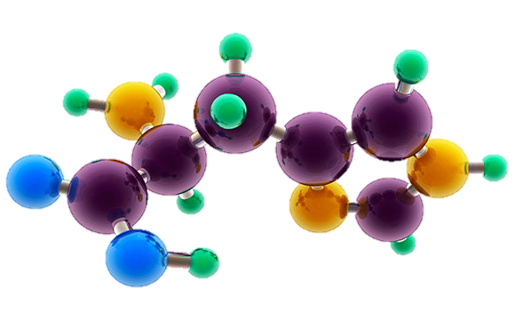
AP Chemistry Exam Review

Slide 2
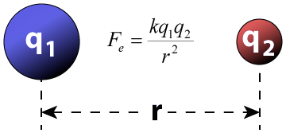
Big Idea #2
Properties of Matter

Slide 3
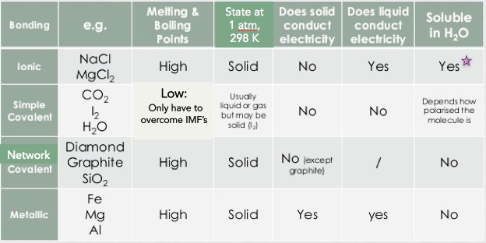
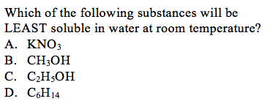
Properties Based on Bonding
Source
Video 1
Video 2
Video 3
Video 4
Visit the Virtual Lab to explore properties based on bond type (click on perform)
Not all ionic compounds are soluble, but those containing ammonium, nitrate, alkali metals, and halogens (except bonded to Ag, Hg and Pb) are typically
LO 2.1: Students can predict properties of substances based on their chemical formulas, and provide explanations of their properties based on particle views

Slide 4
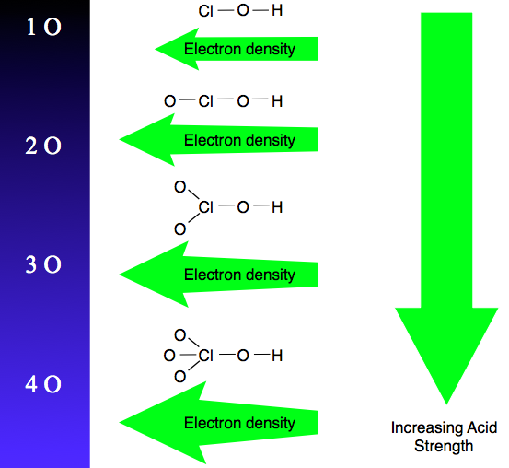
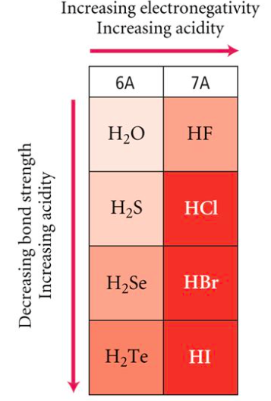
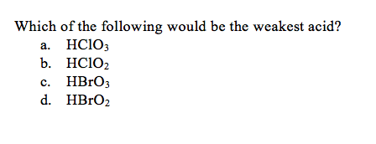
Oxyacid Strength
Binary Acid Strength
Source
LO 2.2: student is able to explain the
relative strengths of acids and bases based on
structure, IMF’s, & equilibrium.
Reading
The increased number of oxygen atoms pulls negative charge away from the O-H bond, weakening the attraction of the proton for the electron pair and thus strengthening the acid.
The greater the size of the negative ion, the weaker its attraction for the proton, and so the stronger the acid, and the weaker the conjugate base. HI is the strongest binary acid.

Slide 5
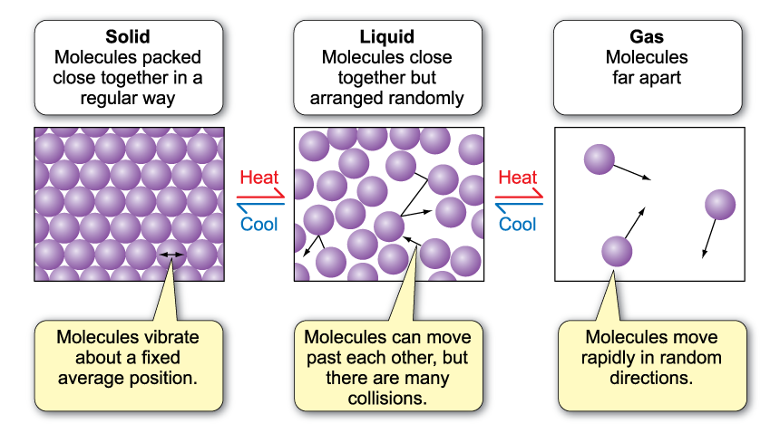
Behaviors of Solids, Liquids, and Gases
Source
Video 1
Video 2
LO 2.3: The student is able to use particulate models to reason about observed differences between solid and liquid phases and among solid and liquid materials.

Slide 6
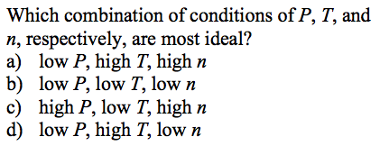
Kinetic Molecular Theory (KMT)
Source
Video 1
Video 2
IF the temperature is not changed, no matter what else is listed in the problem, the average kinetic energy of a gas does not change. That is the definition of temperature!
All gases begin to act non-ideally (aka real) when they are at low temperatures and/or high pressures because these conditions increase particle interactions
Under the same conditions, the stronger the intermolecular attractions between gas particles, the LESS ideal the behavior of the gas
LO 2.4: The student is able to use KMT and IMF’s to make predictions about the macroscopic properties of gases, including both ideal and non-ideal behaviors

Slide 7
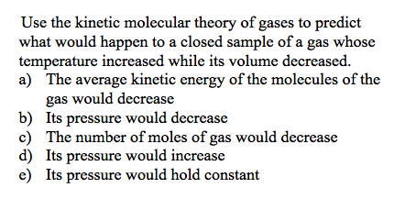
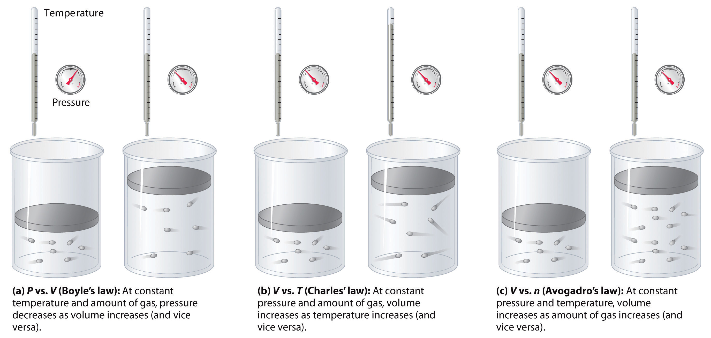
Properties of a Gas - Factors
Source
Don’t worry about individual gas law names, but do worry about the effect of changing moles, pressure and temperature on a sample of gas
Virtual Lab
LO 2.5: Refine multiple representations of a sample of matter in the gas phase to accurately represent the effect of changes in macroscopic properties on the sample

Slide 8
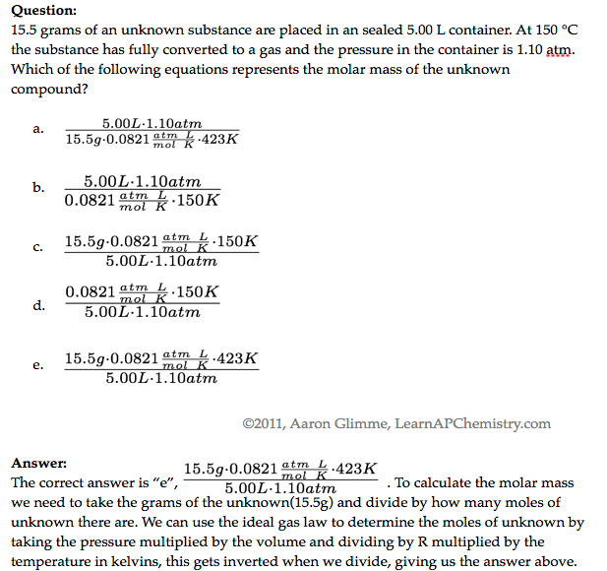
The Ideal Gas Law
Source
Video
LO 2.6: The student can apply mathematical relationships or estimation to determine macroscopic variables for ideal gases
Click reveals answer and explanation.

Slide 9
Chromatography
Source
Video
LO 2.7: The student is able to explain how solutes can be separated by chromatography based on intermolecular interactions.

Slide 10
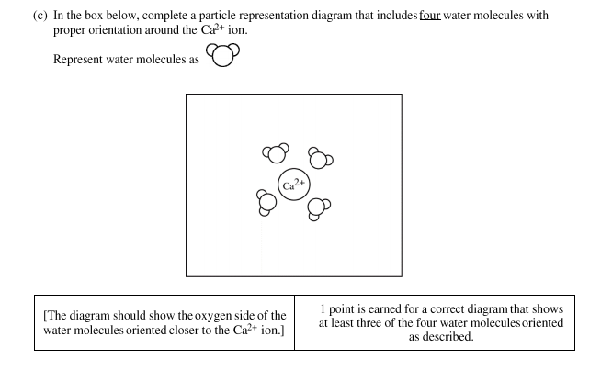
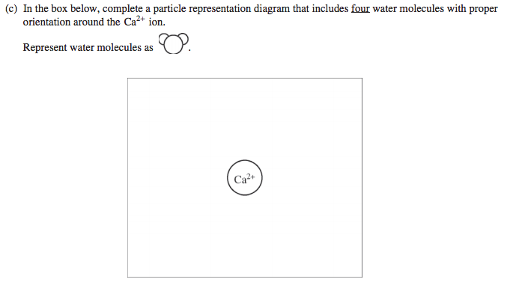
Dissolving/Dissociation: Solute and Solvent
Source
-See 2015 #4 for more information
Video
When drawing solute ions:
pay attention to size (Na⁺ is smaller than Cl⁻)
Draw charges on ion, but not on water
draw at least 3 water molecules around each
the negative dipole (oxygen side) points toward cation and the positive dipoles (H side) points towards the anion
LO 2.8: The student can draw and/or interpret representations of solutions that show the interactions between the solute and solvent.

Slide 11
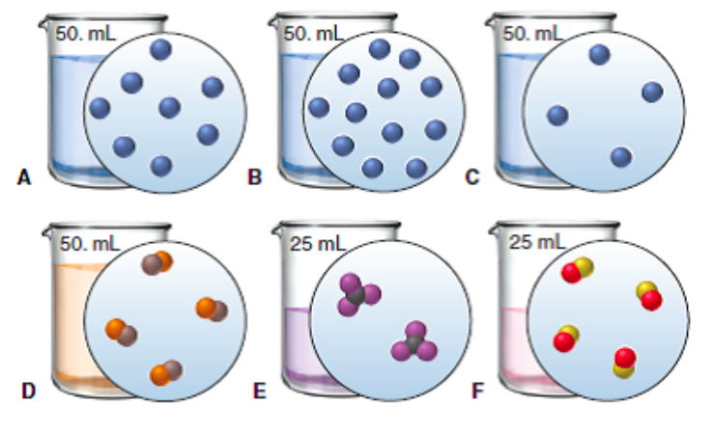
Molarity and Particle Views
Source
Food for thought: if you look at these particulate views as if looking through a microscope at the solution, the volume would irrelevant, and the answer would be E <C, D, F < A < B
Video
QUESTION: Rank the six solutions above in order of increasing molarity. Pay attention to volume, and some have equal concentration
C,D, and E (tied); A and F (tied); most concentrated is B
Click reveals answer
LO 2.9: The student is able to create or interpret representations that link the concept of molarity with particle views of solutions

Slide 12
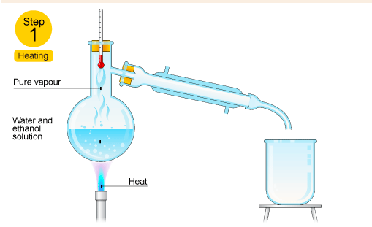
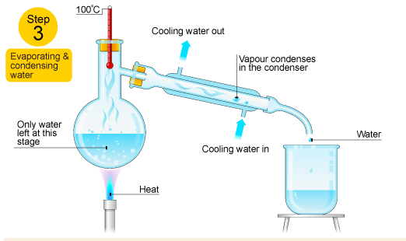
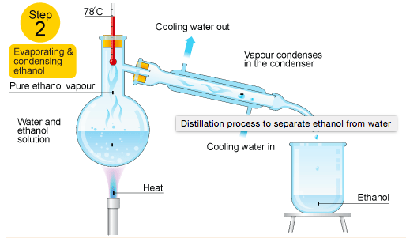
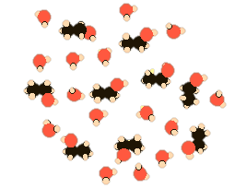
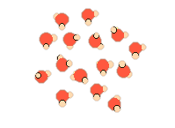
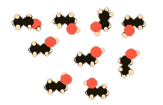
Distillation to Separate Solutions
Source
Video
In the diagram above, ethanol has lower IMF’s and a resulting lower boiling point than water, so it can be heated, vaporized and condensed easily.
Ethanol hydrogen bonds as water does and is polar, but part of the ethanol has only LDF’s because it’s nonpolar resulting in a lower boiling point
LO 2.10: Design/interpret the results of filtration, paper/column chromatography, or distillation in terms of the relative strength of interactions among the components.

Slide 13
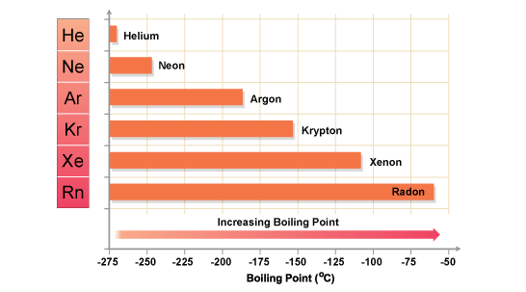
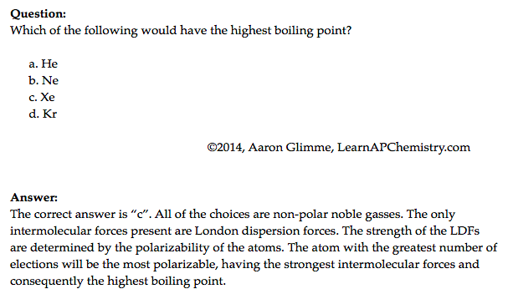
London Dispersion Forces and Noble and Nonpolar Gases
Source
This answer is VITAL! Remember with increased number of ELECTRONS a particle becomes more polarizable, not with increased mass!
Video
Click reveals answer and explanation.
LO 2.11: The student is able to explain the trends in properties/predict properties of samples consisting of particles with no permanent dipole on the basis of LDF’s.

Slide 14
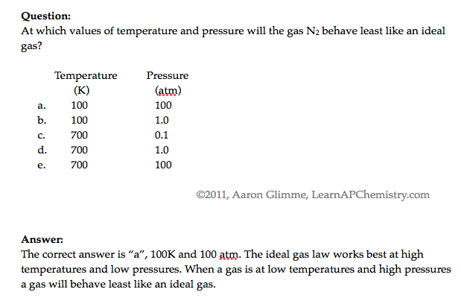
Deviations from Ideal Gas Behavior
Source
Video
When watching the video, don’t concern yourself with Van der Waals – AP Exam focuses on LDF’s instead
Click reveals answer and explanation.
LO 2.12: The student can qualitatively analyze data regarding real gases to identify deviations from ideal behavior and relate these to molecular interactions

Slide 15
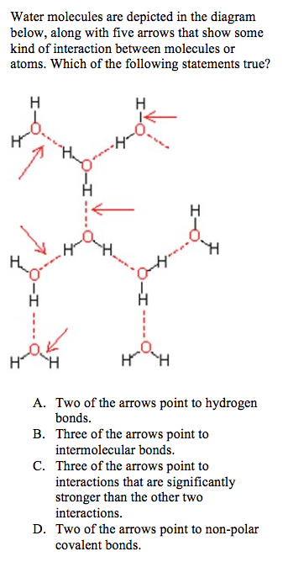
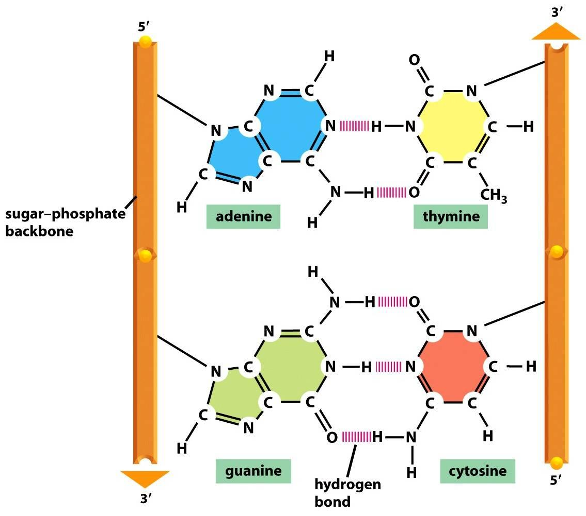
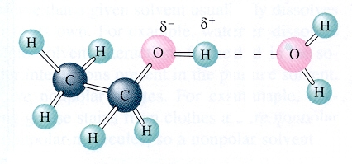
Hydrogen Bonding
Source
Hydrogen bonding is seen in the following molecules: water, DNA, ammonia, HF, and alcohols. H-bonding is an attraction or force not a true intramolecular bond.
Hydrogen bonds are like a sandwich with N, O, and/or F as the bread. H will be in a intramolecular (same molecule) bond with one N, O, and/or F and have an intermolecular attraction (different molecule) with the other.
Video
Remember this tip:
hydrogen bonds just wanna have FON
LO 2.13: The student is able to describe the relationships between the structural features of polar molecules and the forces of attraction between the particles.

Slide 16
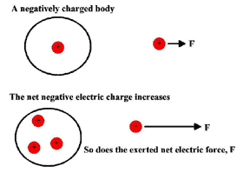
Coulomb’s Law and Solubility
Source
Ionic compounds can dissolve in polar liquids like water because the ions are attracted to either the positive or negative part of the molecule.
There is a sort of tug-of-war involved with species dissolved in water. The water pulls individual ions away from the solid. The solid is pulling individual ions back out of the water. There exists an equilibrium based on how strongly the water attracts the ions, versus how strong the ionic solid attracts the ions.
We can predict the degree of solubility in water for different ionic compounds using Coulomb's law. The smaller the ions, the closer together they are, and the harder it is for the water molecules to pull the ions away from each other. The greater the charge of the ions, the harder it is for the water to pull them away as well.
Video
QUESTION: Predict which of the following pairs should be more soluble in water, based on Coulombic attraction.
LiF or NaF
NaF or KF
BeO or LiF
LO 2.14: Apply Coulomb’s law to describe the interactions of ions, & the attractions of ions/solvents to explain the factors that contribute to solubility of ionic compounds.

Slide 17
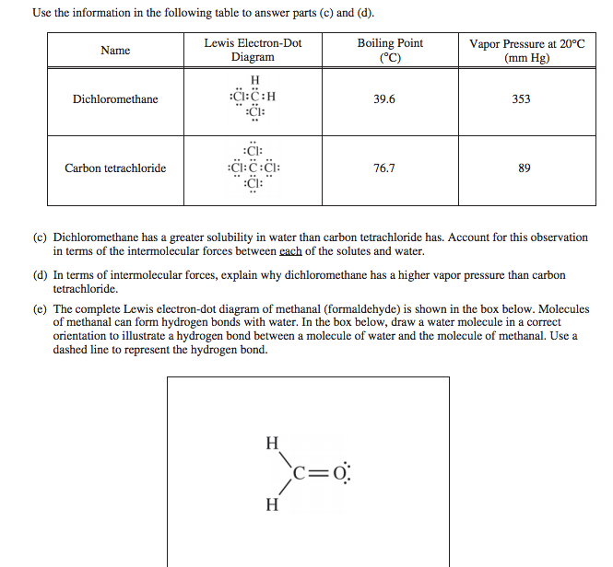
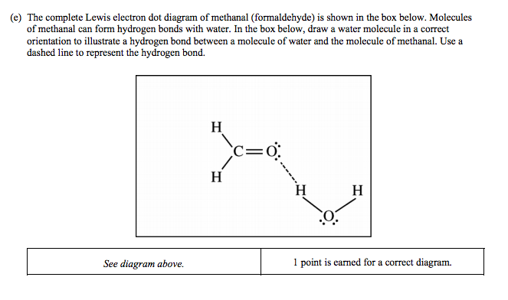
Entropy in Solutions
Source
Video
Do NOT say “like dissolves like.” You’ll, like... get no points.
DO refer to LDF’s, hydrogen bonding and dipole-dipole interactions
Generally speaking. There are exceptions
-See 2013 #6 for more information
LO 2.15: Explain observations of the solubility of ionic solids/molecules in water and other solvents on the basis of particle views that include IMF’s and entropic effects.

Slide 18
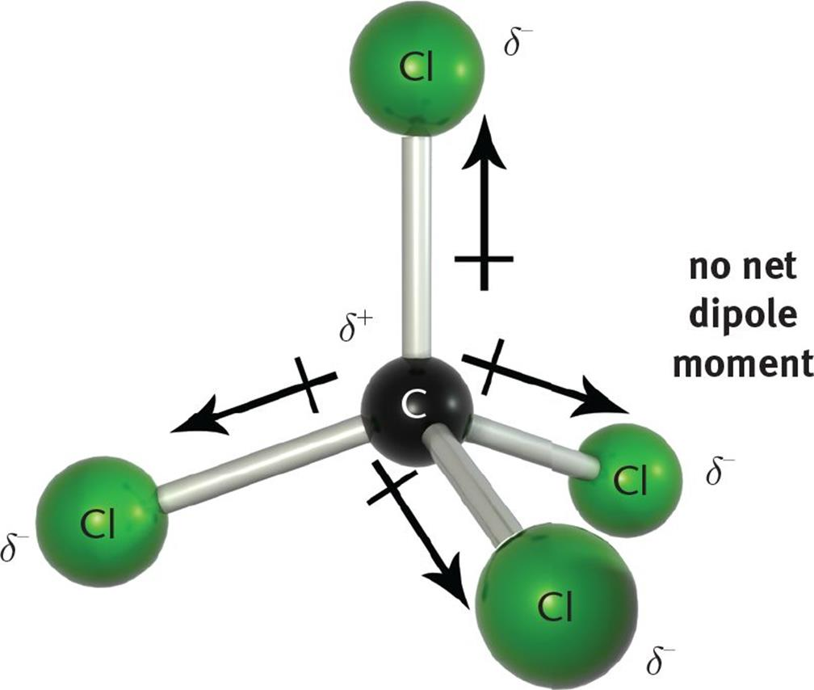
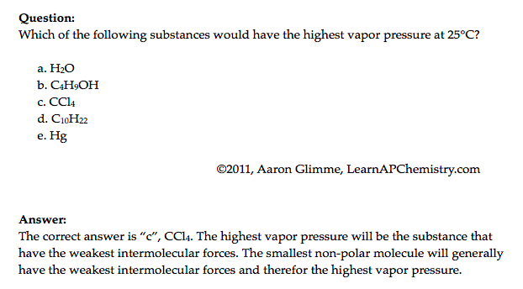
Physical Properties and IMF’s
Source
Video
Hg
Click reveals answer and explanation.
LO 2.16: Explain the properties (phase, vapor pressure, viscosity, etc.) of small and large molecular compounds in terms of the strengths and types of IMF’s.

Slide 19
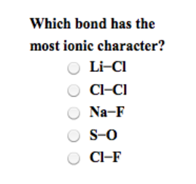
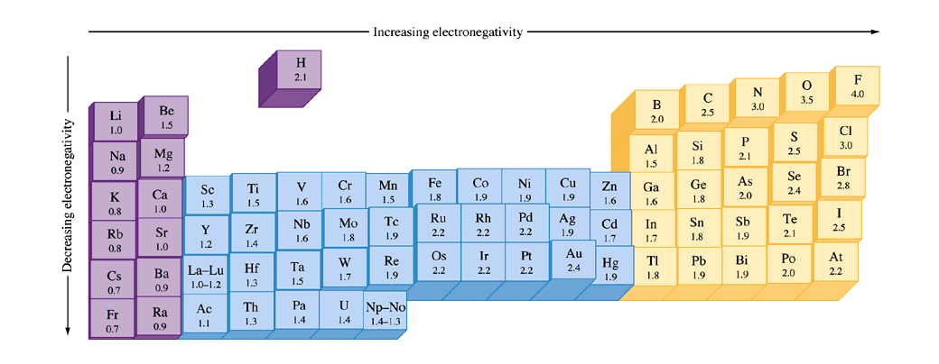
Bonding and Electronegativity
Source
Differences in electronegativities lead to different types of bonding*:
0.0 – 0.4: Bond is generally considered nonpolar
0.5 – 1.7: Bond is generally considered polar
> 1.7: Bond is generally considered ionic
Video
Electronegativities are assigned values and are relative to fluorine. Electronegativity is a function of shielding / effective nuclear charge.
*Values presented are one possibility – other scales exist.
LO 2.17: The student can predict the type of bonding present between two atoms in a binary compound based on position in the periodic table and the electronegativity of the elements.

Slide 20
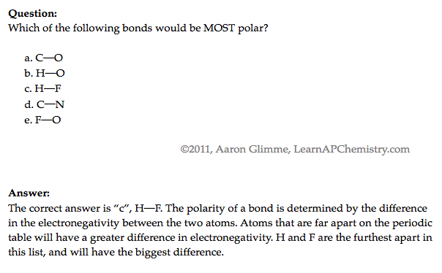
Ranking Bond Polarity
Source
Video
LO 2.18: The student is able to rank and justify the on the ranking of bond polarity on the basis of the locations of the bonded atoms in the periodic table.

Slide 21
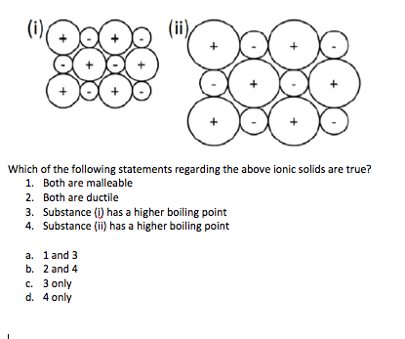
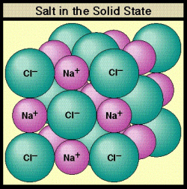
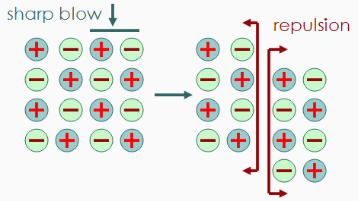
Ionic Substances and their Properties
Source
Ionic compounds are brittle. As the crystal structure is struck, the ions become displaced. The displaced ions will repel like charges and fracture.
Video
LO 2.19: The student can create visual representations of ionic substances that connect the microscopic structure to macroscopic properties and/or use representations to connect microscopic structure to macroscopic properties (e.g., boiling point, solubility, hardness, brittleness, low volatility, lack of malleability, ductility, or conductivity).

Slide 22
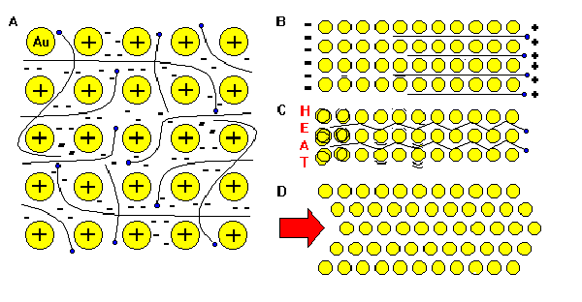
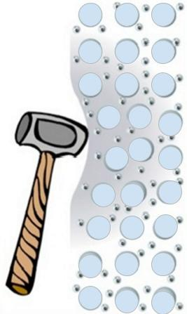
Metallic Properties – Sea of Electrons
Source
Video
“The metallic bond is not the easiest type of bond to understand, so an analogy may help. Imagine filling your bathtub with golf balls. Fill it right up to the top. The golf balls will arrange themselves in an orderly fashion as they fill the space in the tub. Do you see any spaces between the balls? If you turn on the faucet and plug the drain, the water will fill up those spaces. What you now have is something like metallic bonding. The golf balls are the metal kernals, and the water represents the valence electrons shared by all of the atoms.”
LO 2.20: The student is able to explain how a bonding model involving delocalized electrons is consistent with macroscopic properties of metals (e.g., conductivity, malleability, ductility, and low volatility) and the shell model of the atom.

Slide 23
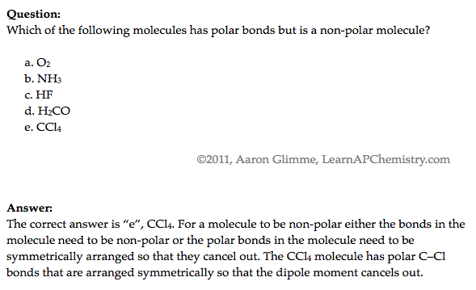
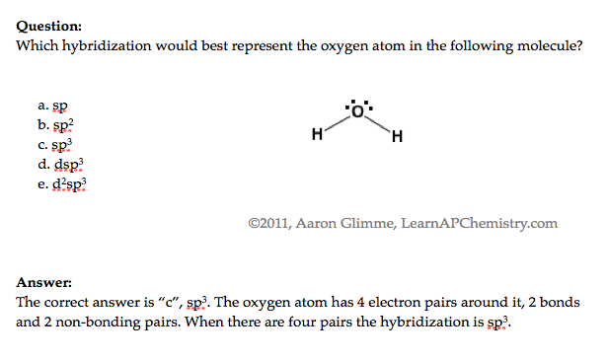
Lewis Diagrams / VSEPR
Source
Video
LO 2.21: The student is able to use Lewis diagrams and VSEPR to predict the geometry of molecules, identify hybridization, and make predictions about polarity.

Slide 24
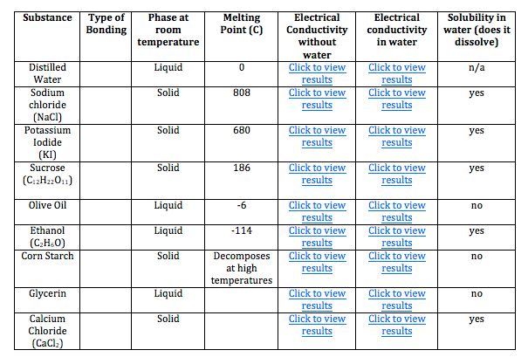
Ionic or Covalent? Bonding Tests
Great Lab Example
Properties | Ionic Compounds | Covalent Compounds
Melting/Boiling Points | High | Low except for some giant covalent molecules
Electrical Conductivity | Conduct electricity in molten and in aqueous solution | Does not conduct electricity in any state when pure, may conduct in aqueous solution (i.e., acids)
Solubility in water and organic solvents | Soluble in water Insoluble in organic solvent | Insoluble in water, except for some simple molecule Soluble in organic solvent
Volatility | Not volatile | Highly volatile
As the type of particles and forced of attraction in ionic and covalent compounds differ, their properties also differ!
Video
Source
Click here to do a virtual lab on bonding type (chart pictured below)
Use properties of compounds to differentiate them from one another. Other tests may be performed to positively identify the compound, but are not necessary to observe types of bonds present.
LO 2.22: The student is able to design or evaluate a plan to collect and/or interpret data needed to deduce the type of bonding in a sample of a solid.

Slide 25
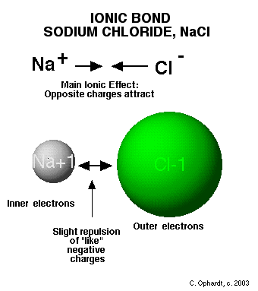
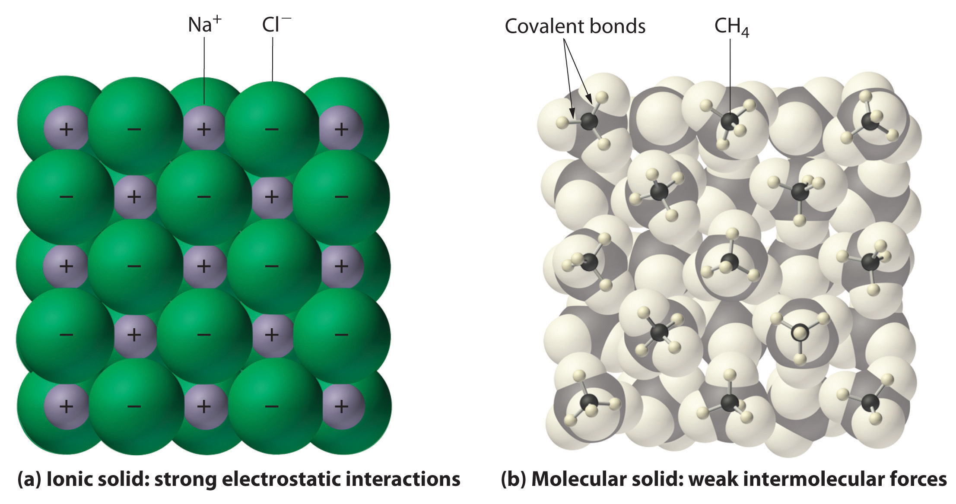
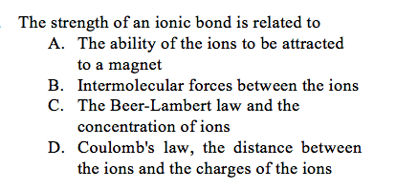
Crystal Structure of Ionic Compounds
Source
Video
LO 2.23: The student can create a representation of an ionic solid that shows essential characteristics of the structure and interactions present in the substance.

Slide 26
Crystal Structure of Ionic Compounds
Source
Video
The +2 and -2 ions attract each other more strongly than +1 attracts -1.
The ions Mg⁺² and O⁻² are smaller than Na⁺¹ and Cl⁻¹, therefore the ions can get closer together, increasing their electrostatic attractions.
LO 2.24: The student is able to explain a representation that connects properties of an ionic solid to its structural attributes and to the interactions present at the atomic level.

Slide 27
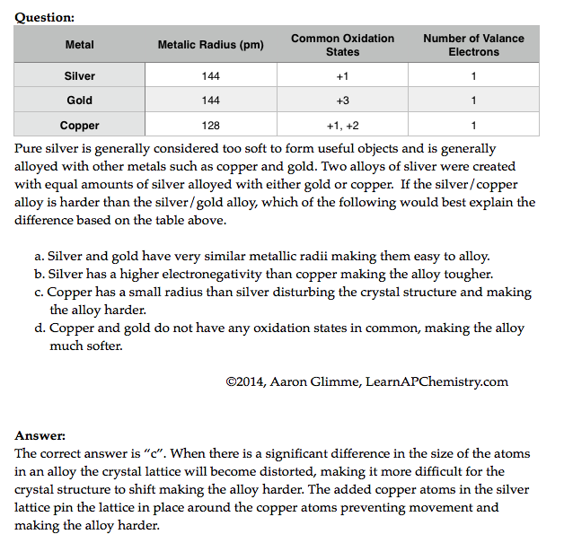
Alloys and their Properties
Source
Video
LO 2.25: The student is able to compare the properties of metal alloys with their constituent elements to determine if an alloy has formed, identify the type of alloy formed, and explain the differences in properties using particulate level reasoning.

Slide 28
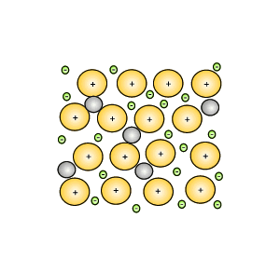
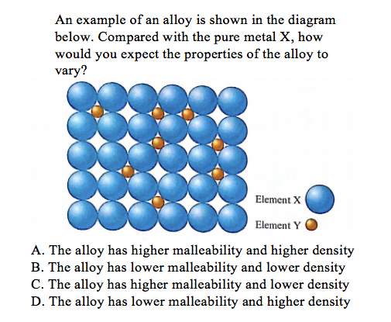
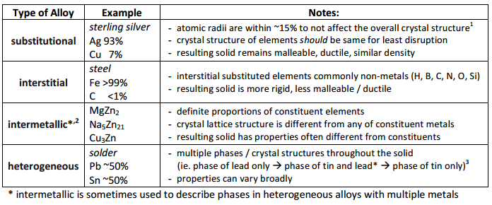
Alloys!
Source
Video
LO 2.26: Students can use the electron sea model of metallic bonding to predict or make claims about macroscopic properties of metals or alloys.

Slide 29
Metallic Solids - Characteristics
Source
Video
LO 2.27: The student can create a representation of a metallic solid that shows essential characteristics of the structure and interactions present in the substance.

Slide 30
Properties of Metallic Solids
Source
Video
LO 2.28: The student is able to explain a representation that connects properties of a metallic solid to its structural attributes and to the interactions present at the atomic level.

Slide 31
Covalent Compounds - Interactions
Source
Graphite are sheets of carbon atoms bonded together and stacked on top of one another. The interactions between sheets is weak, much like the substance itself.
Diamond’s carbon atoms are more connected in a three dimensional structure, adding strength to the network.
Video
LO 2.29: The student can create a representation of a covalent solid that shows essential characteristics of the structure and interactions present in the substance.

Slide 32
Covalent Solids
Source
Video
LO 2.30: The student is able to explain a representation that connects properties of a covalent solid to its structural attributes and to the interactions present at the atomic level.

Slide 33
Molecular Compounds - Interactions
Source
Water (H₂O)
Iodine (I₂)
Video
Polar Covalent compounds align according to dipole-dipole interactions.
Non-Polar Covalent compounds align according to LDF’s as a solid.
LO 2.31: The student can create a representation of a molecular solid that shows essential characteristics of the structure and interactions in the substance.

Slide 34
Molecular Compound Interactions
Source
a. Covalent bonds
b. Hydrogen bonds
c. Dipole-dipole interactions
d. London Dispersion Forces
Video
LO 2.32: The student is able to explain a representation that connects properties of a molecular solid to its structural attributes and to the interactions present at the atomic level.

