Slide 1
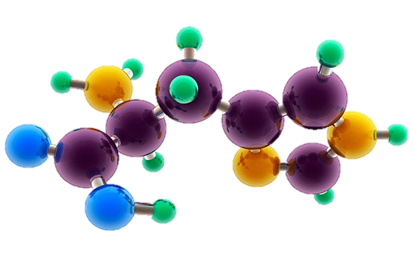
AP Chemistry Exam Review

Slide 2
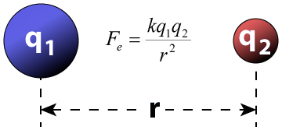
Big Idea #1
Properties of Matter

Slide 3
Ratio of Masses in a Pure Sample
Source
All elements and molecules are made up of atoms
Substances with the same atomic makeup will have same average masses
The ratio of masses of the same substance is independent of size of the substance
Molecules with the same atomic makeup (ex: H₂O) will have the same ratio of average atomic masses
H₂O₂ ratio would be different than H₂O due to the different chemical makeup
H₂O
A 4.5 gram sample of which of the following would have the greatest mass percent of oxygen?
Na₂O (molar mass = 62 g/mol)
Li₂O (molar mass = 30 g/mol)
MgO (molar mass = 40 g/mol)
SrO (molar mass = 104 g/mol)
Answer:
16/62 x 100 = 26 %
16/30 x 100 = 53%
16/40 x 100 = 40%
16/104 x 100 = 15%
Video
108 g/mol
Click reveals answer and explanation.
LO 1.1: Justify the observation that the ratio of the masses of the constituent elements in any pure sample of that compound is always identical on the basis of the atomic molecular theory.

Slide 4
Composition of Pure Substances and/or Mixtures
Source
Percent mass can be used to determine the composition of a substance
% mass can also be used to find the empirical formula
The empirical formula is the simplest formula of a substance
It is a ratio between the moles of each element in the substance
Quick steps to solve!
% to mass, mass to moles, divide by the smallest and multiply ‘til whole!)
The molecular formula is the actual formula of a substance
It is a whole number multiple of the empirical formula
Video
Click reveals answer and explanation.
LO 1.2: Select and apply mathematical routines to mass data to identify or infer the composition of pure substances and/or mixtures.

Slide 5
Identifying Purity of a Substance
Source
Impurities in a substance can change the percent composition by mass
If more of a certain element is added from an impurity, then the percent mass of that element will increase and vice versa
When heating a hydrate, the substance is heated several times to ensure the water is driven off
Then you are simply left with the pure substance and no excess water
Video
The mass percent of oxygen in pure glucose, C₆H₁₂O₆ is 53.3 percent. A chemist analyzes a sample of glucose that contains impurities and determines that the mass percent of oxygen is 49.7 percent. Which of the follow impurities could account for the low mass percent of oxygen in the sample?
n-eicosane (C₂₀H₄₂)
ribose C₅H₁₀O₅
fructose, C₆H₁₂O₆
sucrose C₁₂H₂₂O₁₁
a. has the lowest percent by mass of O
LO 1.3: The student is able to select and apply mathematical relationships to mass data in order to justify a claim regarding the identity and/or estimated purity of a substance.

Slide 6
Mole Calculations
Source
1 mole = 6.02 x 10²³ representative particles
1 mole = molar mass of a substance
1 mole = 22.4 L of a gas at STP
Video
Click reveals answer and explanation.
LO 1.4: The student is able to connect the number of particles, moles, mass and volume of substances to one another, both qualitatively and quantitatively.

Slide 7
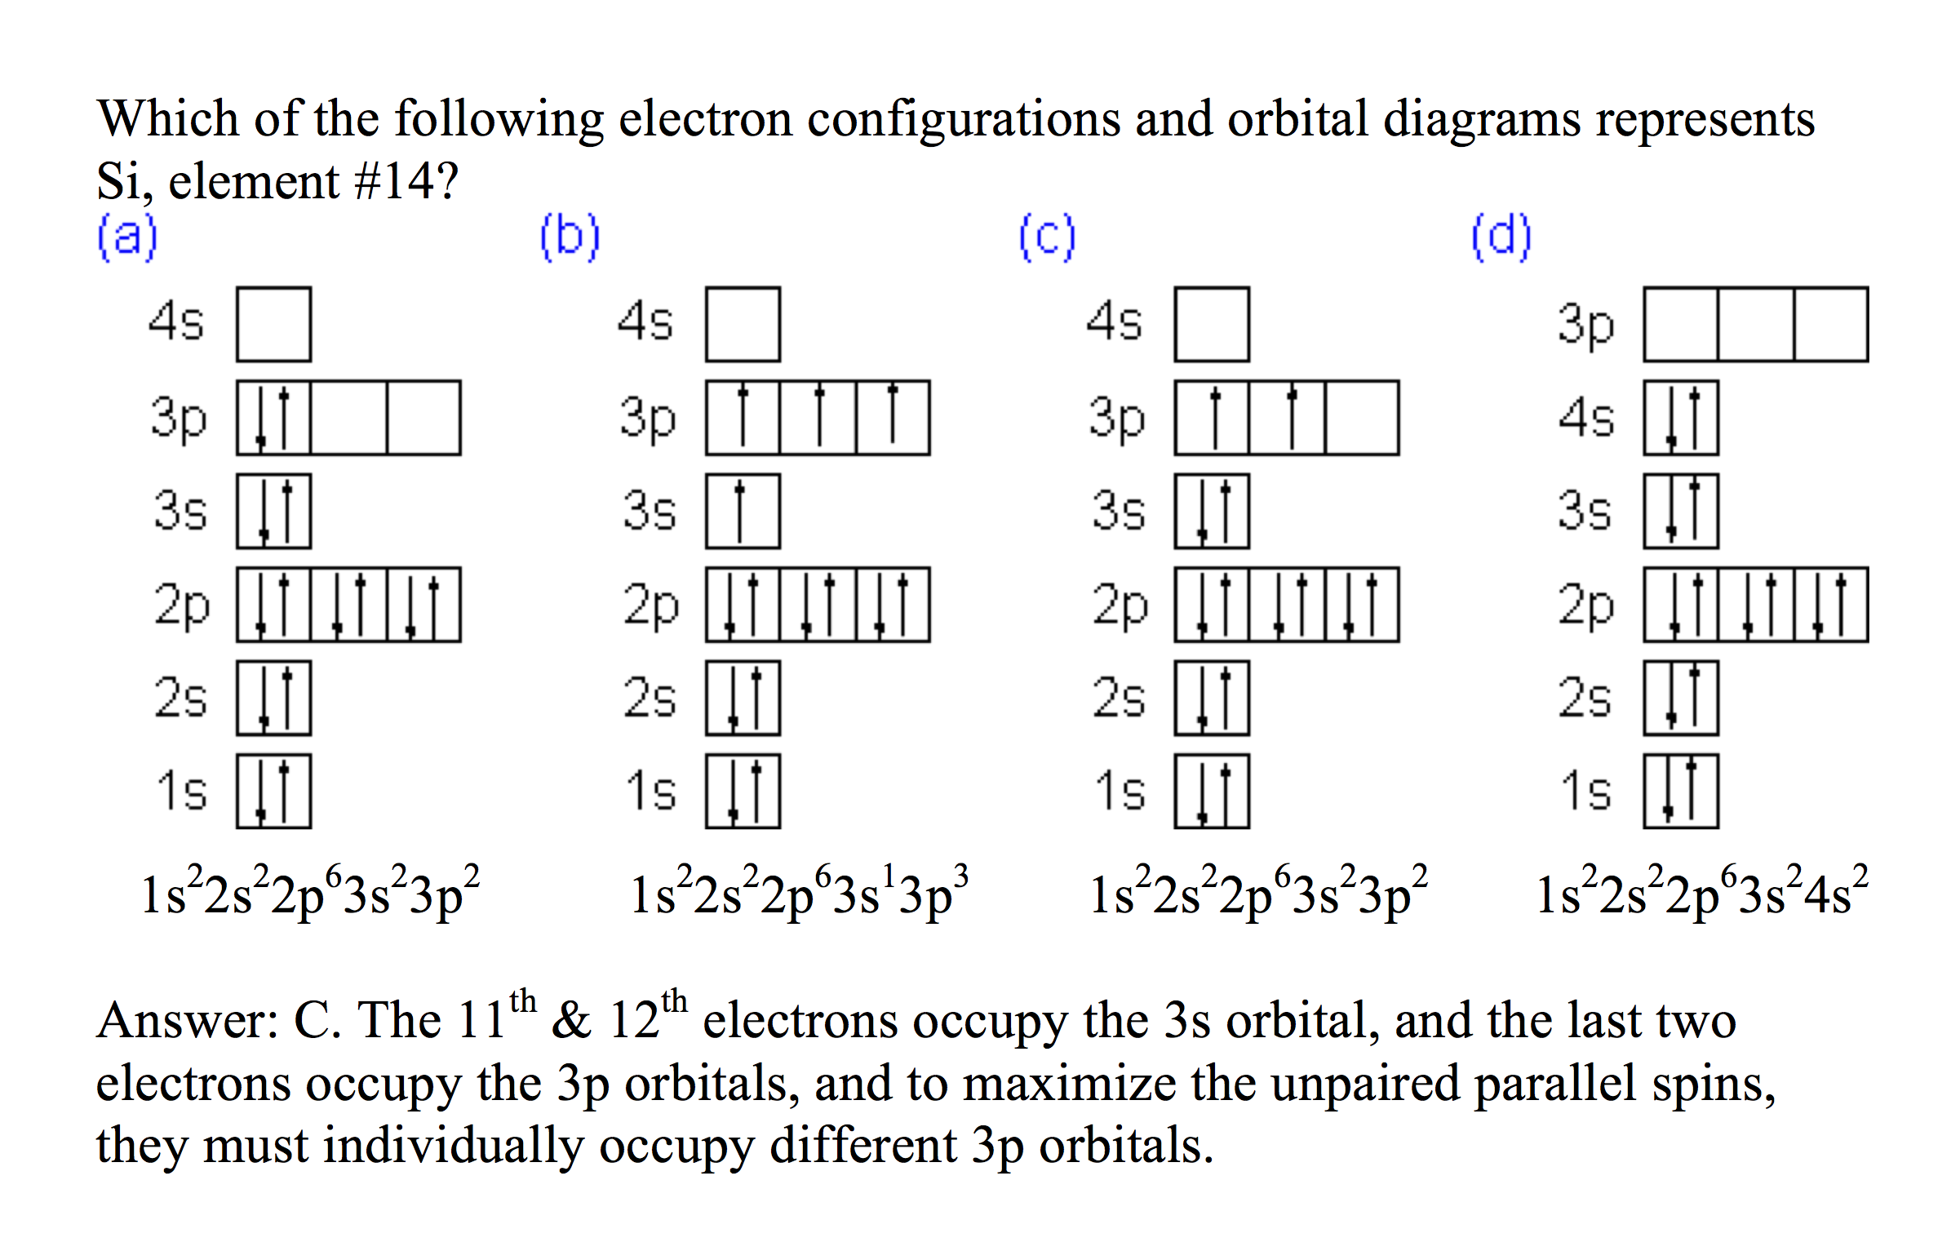
Electronic Structure of the Atom: Electron Configurations
Source
Electrons occupy orbitals whose energy level depends on the nuclear charge and average distance to the nucleus
Electron configurations & orbital diagrams indicate the arrangement of electrons with the lowest energy (most stable):
Electrons occupy lowest available energy levels
A maximum of two electrons may occupy an energy level
Each must have opposite spin (±½)
In orbitals of equal energy, electrons maximize parallel unpaired spins
Video
Click reveals answer and explanation.
LO 1.5: The student is able to explain the distribution of electrons in an atom or ion based upon data.

Slide 8
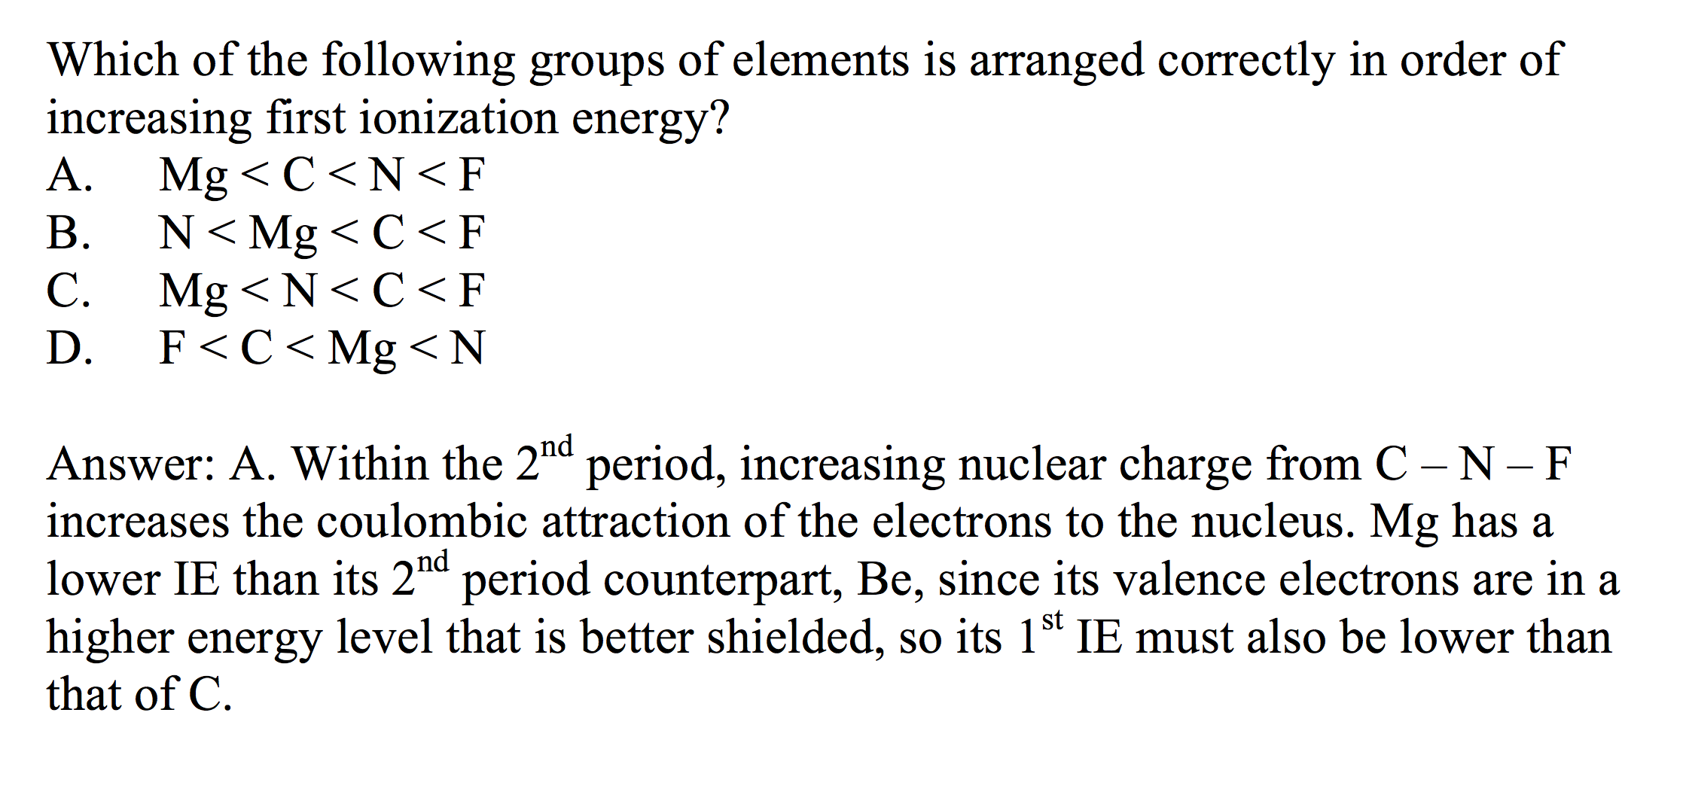
Electronic Structure of the Atom: 1st Ionization Energy
Source
1st Ionization Energy (IE) indicates the strength of the coulombic attraction of the outermost, easiest to remove, electron to the nucleus:
X(g) + IE X⁺(g) + e–
1st IE generally increases across a period and decreases down a group
IE generally increases as #protons increases in same energy level
IE decreases as e– in higher energy level: increased shielding, e– farther from nucleus
Video
Click reveals answer and explanation.
LO 1.6: The student is able to analyze data relating to electron energies for patterns and relationships.

Slide 9
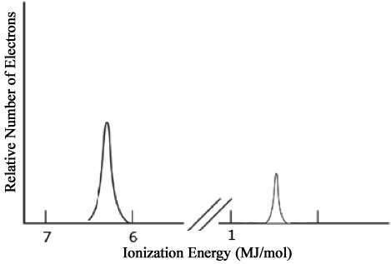
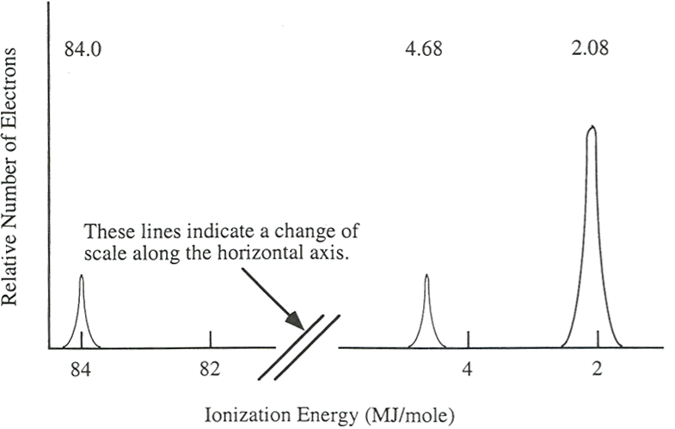
Electronic Structure of the Atom: Photoelectron Spectroscopy (PES)
Source
Li
PES uses high-energy (X-ray) photon to excite random e– from atom
KE of ejected electron indicates binding energy (coulombic attraction) to nucleus:
BE = hϖ_{photon} – KE
Direct measurement of energy and number of each electron
Lower energy levels have higher BE
Signal size proportional to number of e– in energy level
Elements with more protons have stronger coulombic attraction, higher BE at each energy level
1s²
Video
2s¹
Ne
2p⁶
1s²
2s²
Click reveals answer and explanation.
LO 1.7: The student is able to describe the electronic structure of the atom, using PES data, ionization energy data, and/or Coulomb’s law to construct explanations of how the energies of electrons within shells in atoms vary.

Slide 10
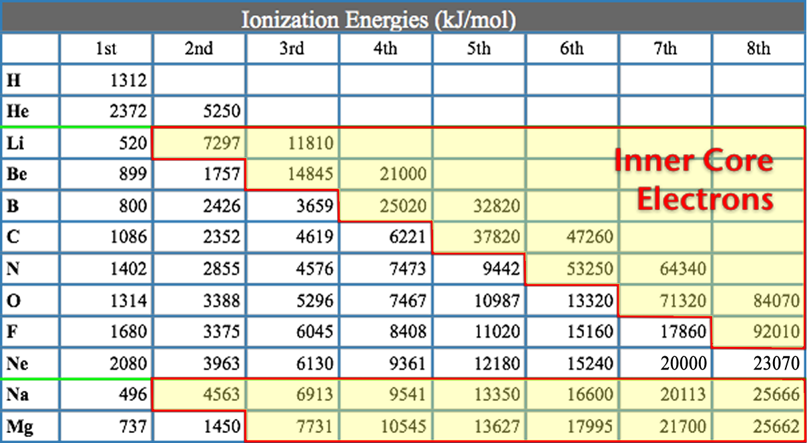
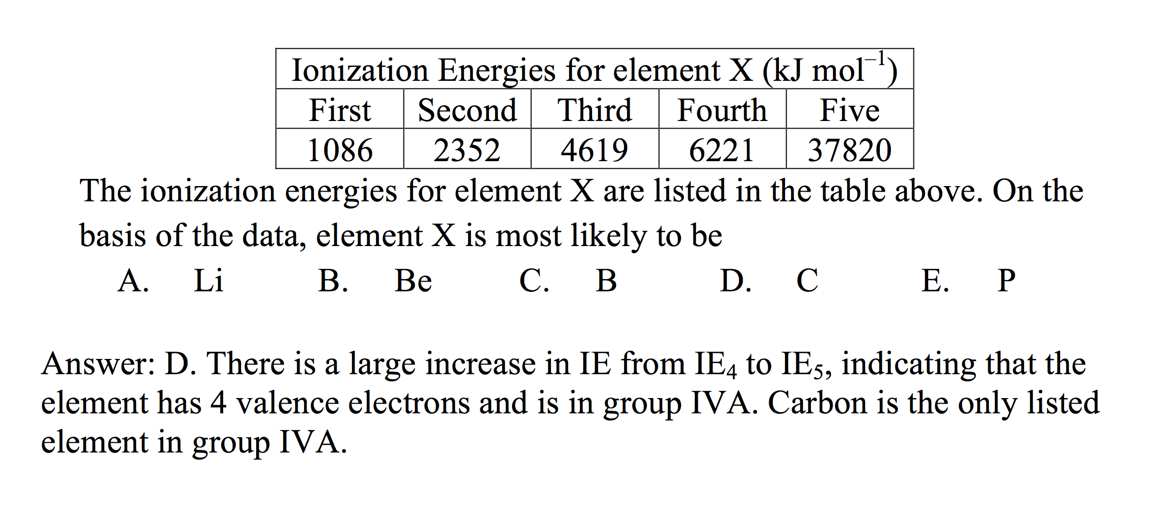
Electronic Structure of the Atom: Higher Ionization Energies
Source
2nd & subsequent IE’s increase as coulombic attraction of remaining e–’s to nucleus increases
X⁺ + IE X²⁺ + e–
X²⁺ + IE X³⁺ + e–
Large jump in IE when removing less-shielded core electrons
Video
Click reveals answer and explanation.
LO 1.8: The student is able to explain the distribution of electrons using Coulomb’s law to analyze measured energies.

Slide 11
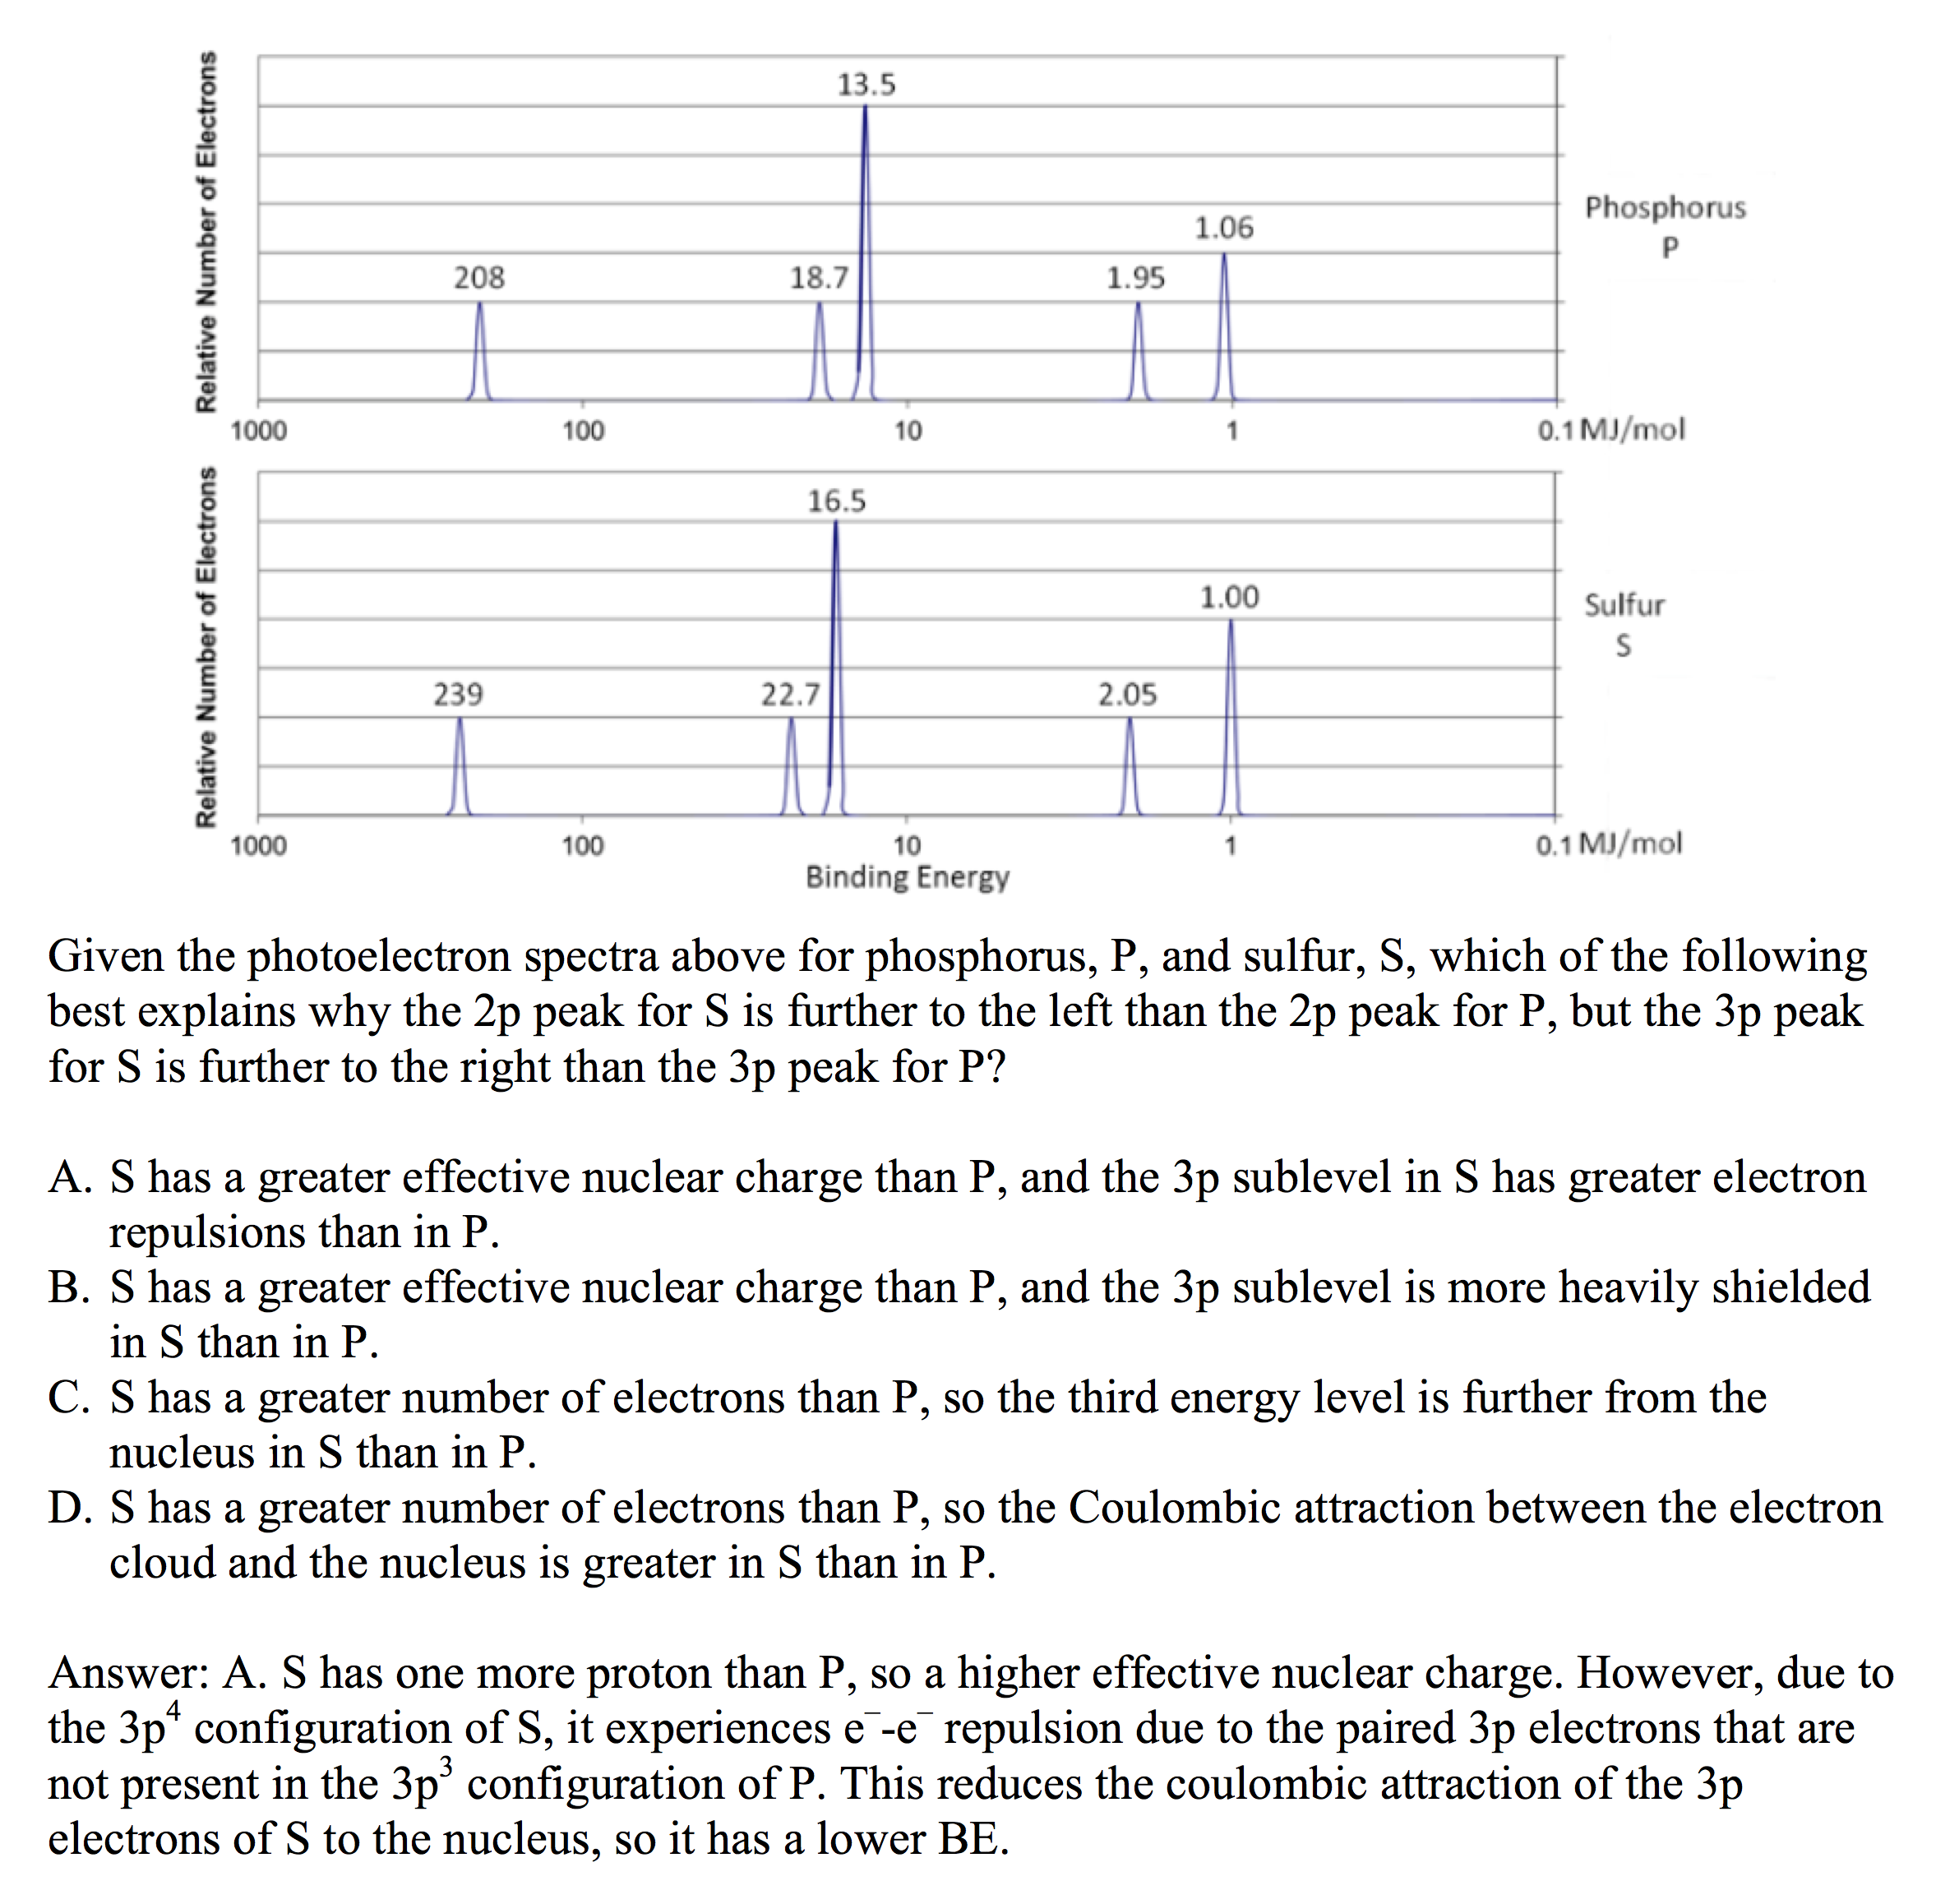
Electronic Structure of the Atom: 1st Ionization Energy Irregularities
Source
1st Ionization Energy Energy (IE) decreases from Be to B and Mg to Al
Electron in 2p or 3p shielded by 2s² or 3s² electrons, decreasing coulombic attraction despite additional proton in nucleus.
Same effect seen in 3d¹⁰-4p, 4d¹⁰-5p and 5d¹⁰-6p
1st Ionization Energy decreases from N to O and P to S
np⁴ contains first paired p electrons, e–-e– repulsion decreases coulombic attraction despite additional proton
Video
Click reveals answer and explanation.
LO 1.8: The student is able to explain the distribution of electrons using Coulomb’s law to analyze measured energies.

Slide 12
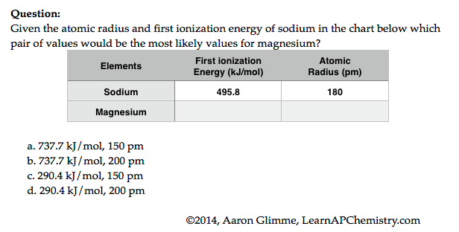
Predictions with Periodic Trends
Sources
Video
The following explains these trends:
Electrons attracted to the protons in the nucleus of an atom
So the closer an electron is to a nucleus, the more strongly it is attracted (Coulomb’s law)
The more protons in a nucleus (effective nuclear force), the more strongly it attracts electrons
Electrons are repelled by other electrons in an atom. If valence electrons are shielded from nucleus by other electrons, you will have less attraction of the nucleus (again Coulomb’s law-greater the atomic radius, the greater the distance)
its
attracts
L.O. 1.9 The student is able to predict and/or justify trends in atomic properties based on location on periodic table and/or the shell model

Slide 13
Chemical Reactivity
Source
Using Trends
Nonmetals have higher electronegativities than metals --> causes the formation of ionic solids
Compounds formed between nonmetals are molecular
Usually gases, liquids, or volatile solids at room temperature
Elements in the 3rd period and below can accommodate a larger number of bonds
The first element in a group (upper most element of a group) forms pi bonds more easily (most significant in 2nd row, non-metals)
Accounts for stronger bonds in molecules containing these elements
Major factor in determining the structures of compounds formed from these elements
Elements in periods 3-6 tend to form only single bonds
Reactivity tends to increase as you go down a group for metals and up a group for non-metals.
46) Of the elements below, __________ reacts the most quickly with water.
A) sodium
B) barium
C) calcium
D) cesium
E) magnesium
Video
L.O. 1.10: Students can justify with evidence the arrangement of the periodic table and can apply periodic properties to chemical reactivity

Slide 14
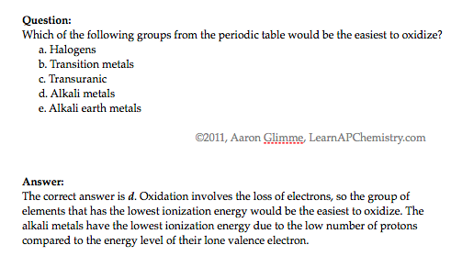
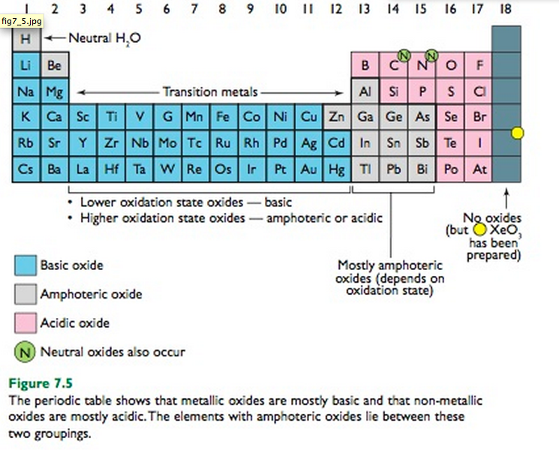
Chemical Properties within a Group and across a Period
Source
Group 1 metals more
reactive than group 2
metals
Reactivity increases as you go down a group
Metals on left form basic oxides
Ex. Na₂O + H₂O → 2 NaOH
Nonmetals on right form form acidic oxides
Ex. SO₃ + H₂O → H₂SO₄
Elements in the middle, like Al, Ga, etc can behave amphoterically
If SiO₂ can be a ceramic then SnO₂ may be as well since both in the same group
Video
Click reveals answer and explanation.
its
attracts
LO 1.11: Analyze data, based on periodicity & properties of binary compounds, to identify patterns & generate hypotheses related to molecular design of compounds

Slide 15
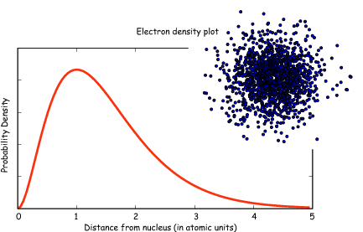
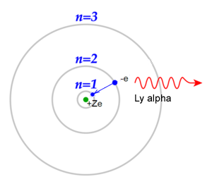
Classic Shell Model of Atom vs
Quantum Mechanical Model
Source
Quantum Mechanical Model
Developed by Schrodinger and the position of an electron is now
represented by a wave equation
Most probable place of finding an electron is called an ORBITAL (90% probability)
Each orbital can only hold 2 electrons with opposing spins (S, P, D & F orbitals)
Evidence for this theory:
Work of DeBroglie and PLanck that electron had wavelike characteristics
Heisenberg Uncertainty Principle - impossible to predict exact location of electron- contradicted Bohr
This new evidence caused the Shell Theory to be replaced by the Quantum Mechanical Model of the atom
Shell Model - Bohr
Developed by Schrodinger and the position of an electron is now
represented by a wave equation
Most probable place of finding an electron is called an ORBITAL (90% probability)
Each orbital can only hold 2 electrons with opposing spins (S, P, D & F orbitals)
Evidence for this theory:
Work of DeBroglie and Planck that electron had wavelike characteristics
Heisenberg Uncertainty Principle - impossible to predict exact location of electron- contradicted Bohr
This new evidence caused the Shell Theory to be replaced by the Quantum Mechanical Model of the atom
Video
LO 1.12: Explain why data suggests (or not) the need to refine a model from a classical shell model with the quantum mechanical model

Slide 16
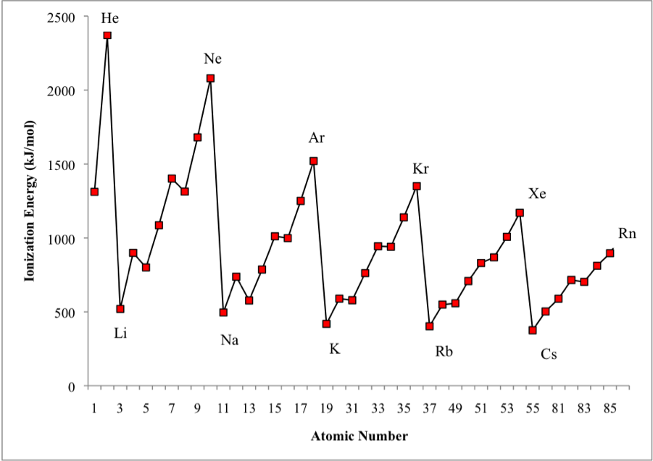
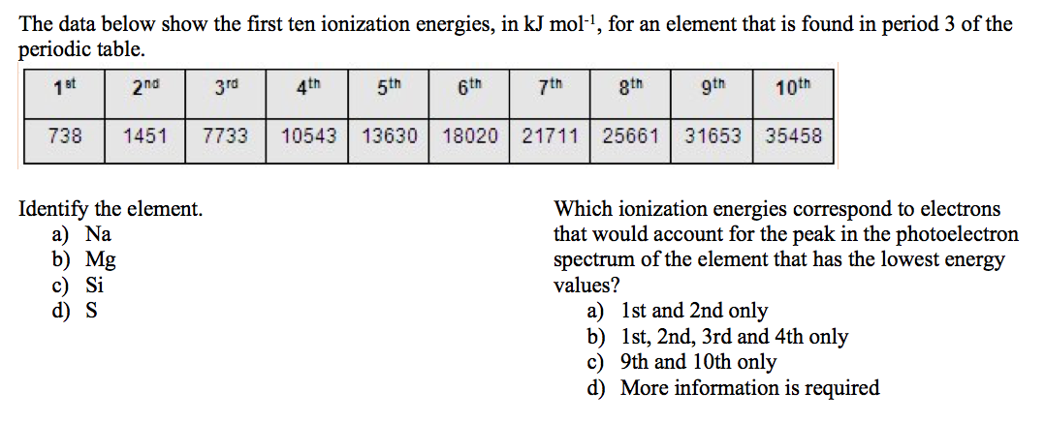
Shell Model is consistent with Ionization Energy Data
Source
The patterns shown by
the IE graph can be
explained by Coulomb’s law
As atomic number increases, would expect the ionization energy to constantly increase
Graph shows that this is NOT observed. WHY NOT?
The data implies that a shell becomes full at the end of each period
Therefore the next electron added must be in a new shell farther away from the nucleus.
This is supported by the fact that the ionization energy drops despite the addition positive charge in the nucleus
Video
LO: 1.13 Given information about a particular model of the atom, the student is able to determine if the model is consistent with specified evidence

Slide 17
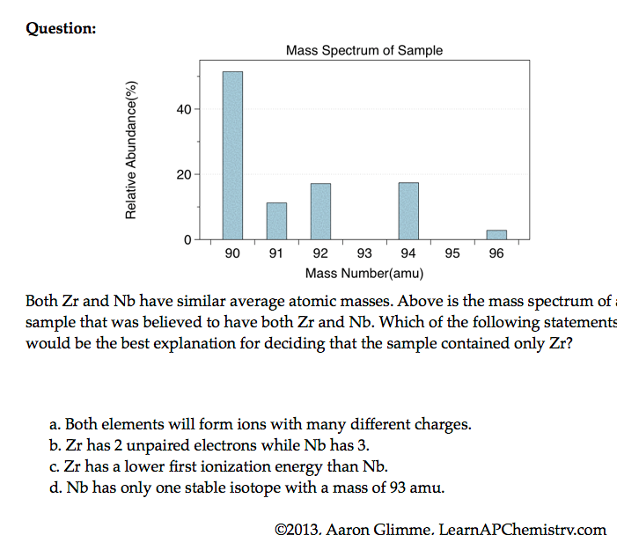
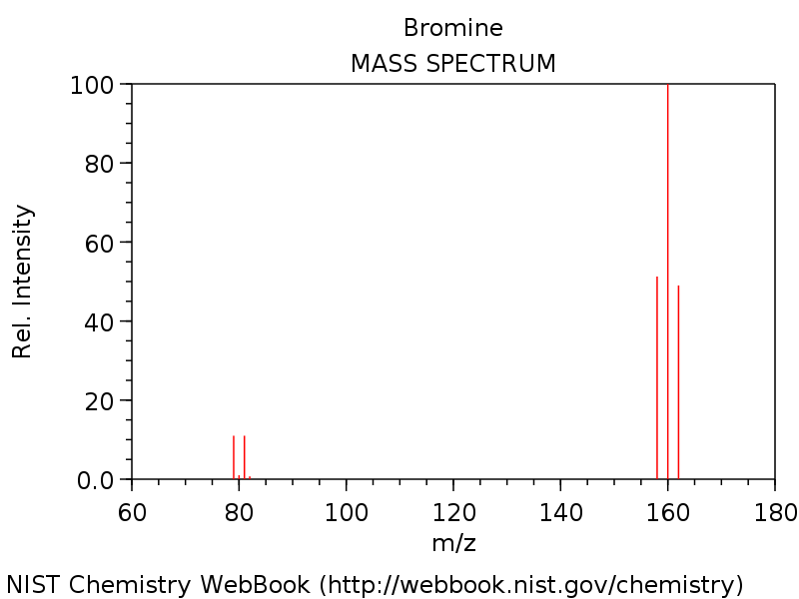
Mass Spectrometry - evidence for isotopes
Source
Mass spectrometry showed
that elements have isotopes
This contradicted Dalton’s early model of the atom which stated that all atoms of an element are identical
3 Br₂ & two Br isotopes shown in diagram
The average atomic mass of the element can be estimated from mass spectroscopy
Video
LO 1.14: The student is able to use the data from mass spectrometry to identify the elements and the masses of individual atoms of a specific element

Slide 18
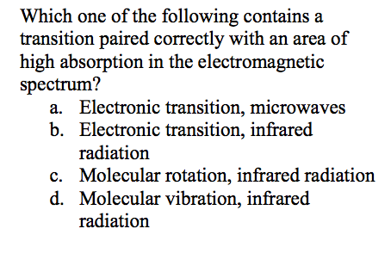
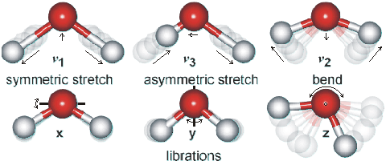
Using Spectroscopy to measure properties associated with vibrational or electronic motions of molecules
Source
IR Video
UV Video
IR Radiation - detects different types of bonds by analyzing molecular vibrations
UV or X-Ray Radiation
Photoelectron Spectroscopy(PES)
Causes electron transitions
Transitions provides info on
electron configurations
LO: 1.15 Justify the selection of a particular type of spectroscopy to measure properties associated with vibrational or electronic motions of molecules

Slide 19
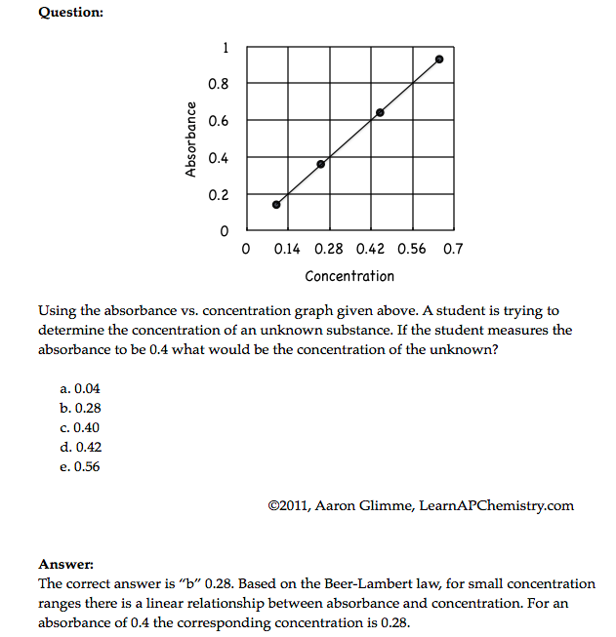
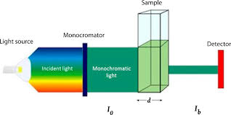
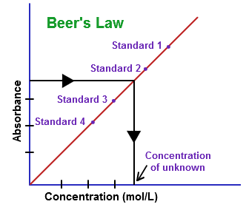
Beer-Lambert Law - used to measure the concentration of colored solutions
Source 1, 2
Video
A = abc
A = absorbance
a = molar absorptivity (constant for material being tested)
b = path length (cuvette = 1 cm)
c = concentration
Taken at fixed wavelength
Click reveals answer and explanation.
LO1.16: Design and/or interpret the results of an experiment regarding the absorption of light to determine the concentration of an absorbing species in solution

Slide 20
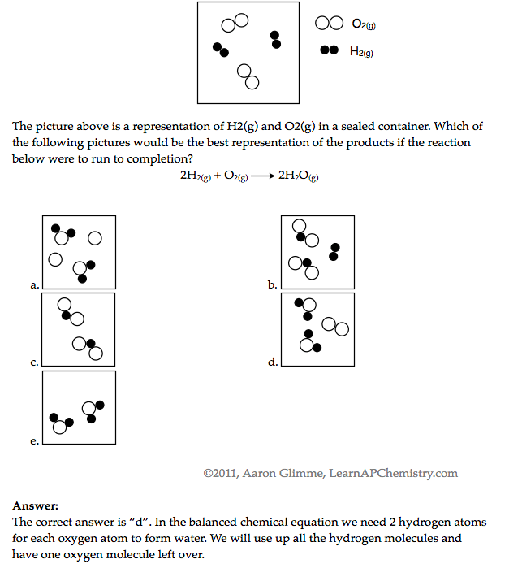
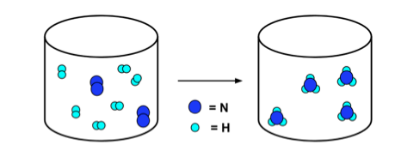
Law of Conservation of Mass
Source
Video
N₂ + 3H₂ → 2NH₃
Click reveals answer and explanation.
LO1.17: Express the law of conservation of mass quantitatively and qualitatively using symbolic representations and particulate drawings

Slide 21
Use Mole Ratio in balanced equation to calculate moles of unknown substance
Source
Video
LO1.18: Apply the conservation of atoms to the rearrangement of atoms in various processes.

Slide 22
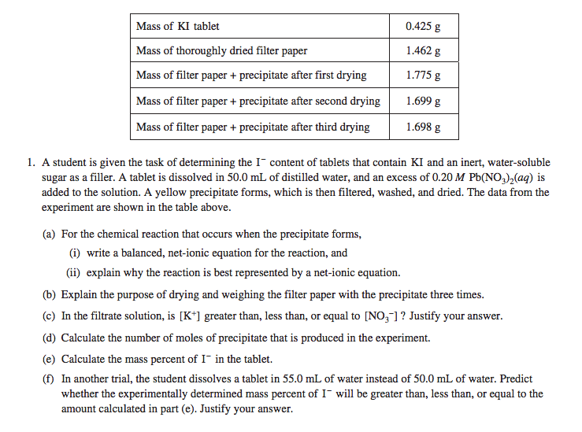
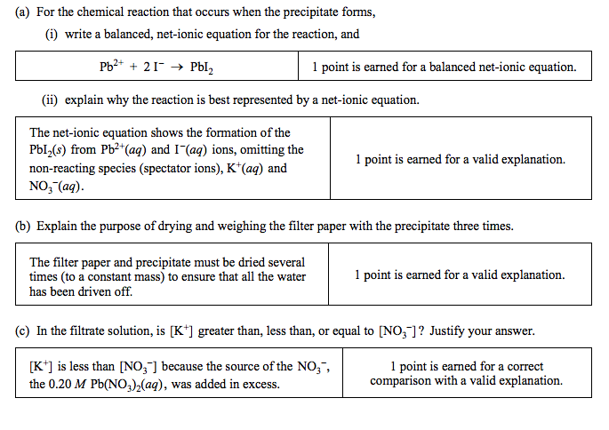
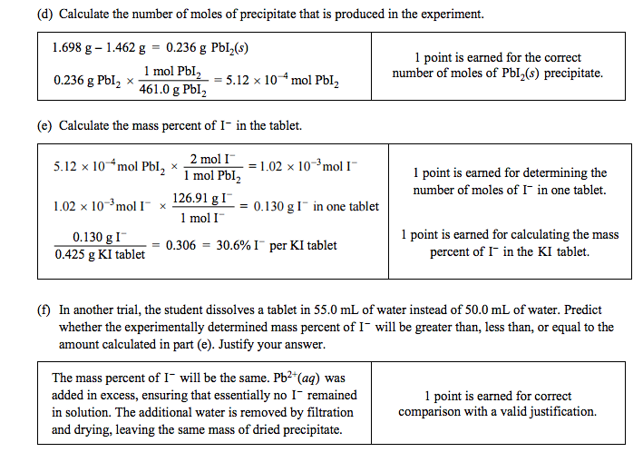
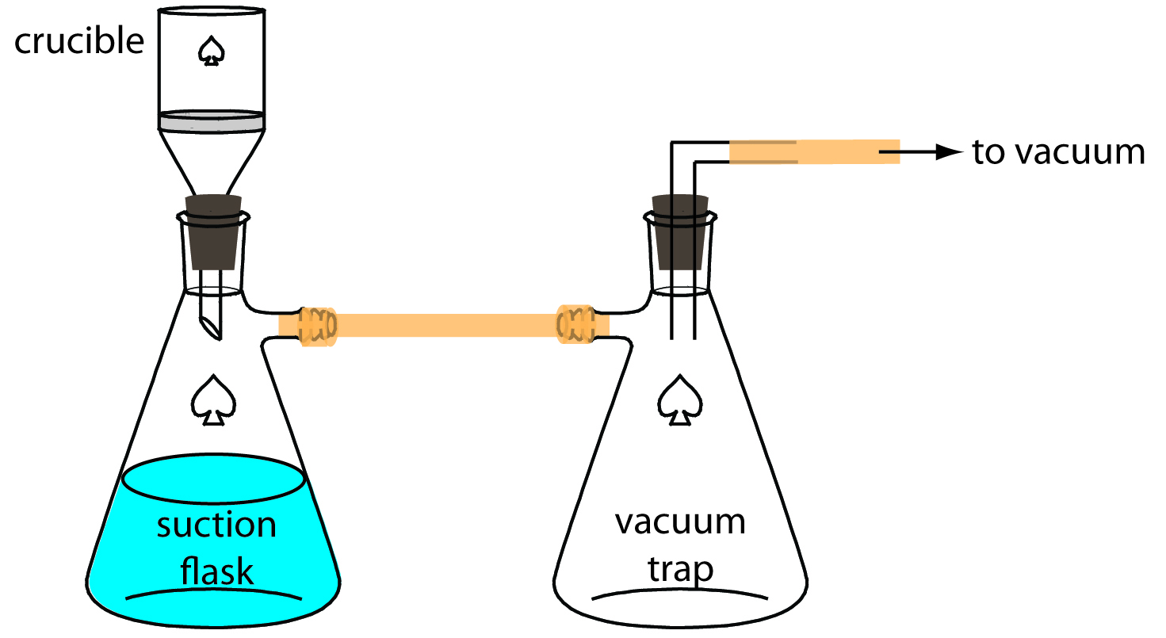
Gravimetric Analysis
Source
Buchner Filtration Apparatus
Video
How much lead
(Pb²⁺) in water?
Pb²⁺(aq) + 2Cl⁻(aq) → PbCl₂ (s)
By adding excess Cl- to the sample, all of the Pb²⁺ will precipitate as PbCl₂
Solid product is filtered using a Buchner Filter and then dried to remove all water
Mass of PbCl₂is then determined
This can be used to calculate the original amount of lead in the water
-See 2014 #1 for more information
LO 1.19: Design and/or interpret data from, an experiment that uses gravimetric analysis to determine the the concentration of an analyte in a solution.
Notes:
2014 #1 Released FRQ’s http://media.collegeboard.com/digitalServices/pdf/ap/ap14_chemistry_scoring_guidelines.pdf

Slide 23
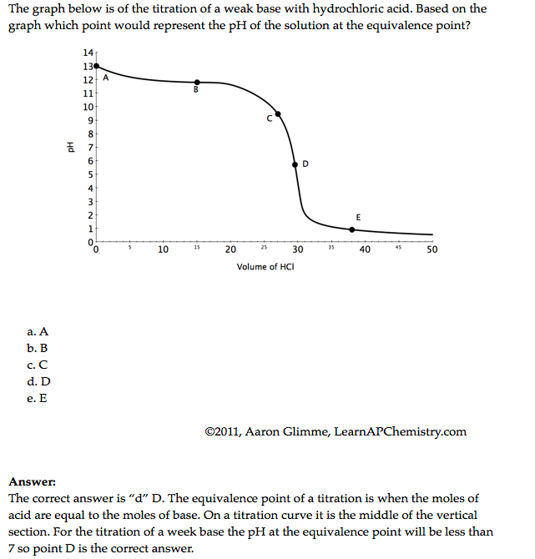
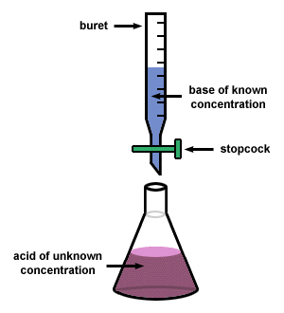
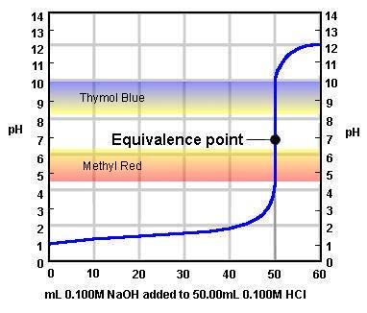
Using titrations to determine concentration of an analyte
Source
Video
At the equivalence point, the stoichiometric molar ratio is reached
Click reveals answer and explanation.
LO1.20: Design and/or interpret data from an experiment that uses titration to determine the concentration of an analyte in a solution.

