Slide 1
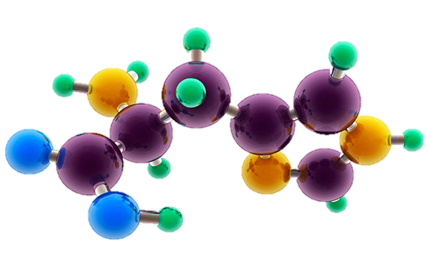
AP Chemistry Exam Review

Slide 2
Big Idea #5
Thermochemistry

Slide 3
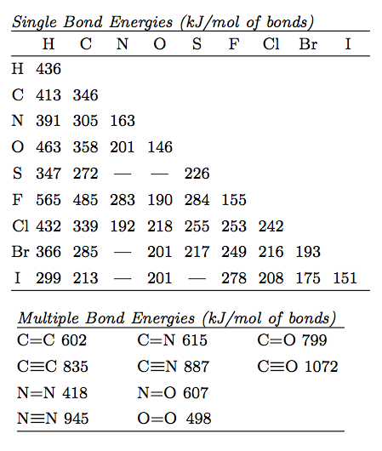
Bond Energy, Length & Strength
Source
Bond strength is determined by the distance between the atoms in a molecule and bond order. Multiple bonds(double, triple) shorten the distance & increase the force of attraction between atoms in a molecule.
Bond Energy is always ENDOTHERMIC –the energy needed to break the bond.
Video
3 Factors
1) Size: H-Cl is smaller than
H-Br
2) Polarity: HCl is more polar than H-C
3) Bond order (length) C=C involves more e- is shorter than C-C.
Lowest PE =Bond Energy
LO: 5.1 The student is able to create or use graphical representations in order to connect the dependence of potential energy to the distance between atoms and factors, such as bond order and polarity, which influence the interaction strength.

Slide 4
LO 5.1 Practice FRQ from 2005 B
Reveal Answer

Slide 5
Maxwell –Boltzmann Distributions
Source
Temperature is a measure of the average Kinetic Energy of a sample of substance.
Particles with larger mass will have a lower velocity but the same Average KE at the same Temperature.
Kinetic Energy is directly proportional to the temperature of particles in a substance. (if you double the Kelvin Temp you double the KE)
The M-B Distribution shows that the distribution of KE becomes greater at higher temperature.
The areas under the curve are equal and therefore the number of molecules is constant
Increasing Temperature (KE) increases the number of particles with the Activation Energy necessary to react.
Activation Energy is not changed with temperature but may be changed with a catalyst.
Video
LO 5.2: The student is able to relate Temp to motions of particles in particulate representations including velocity , and/ or via KE and distributions of KE of the particles.

Slide 6
LO 5.2 Practice FRQ from 2011 B
Reveal Answer
Reveal Answer

Slide 7
Thermodynamic vocabulary
Source
Universe: The sum of the system and surroundings
System: The species we want to study
Surroundings: the environment outside the system
Endothermic: Heat flows to the system from the surroundings (surroundings temperature drops-i.e. beaker feels cold)
Exothermic: Heat flows from the system to the surroundings. (surroundings temperature rises-i.e. beaker feels hot)
Video
LO 5.3: The student can generate explanations or make predictions about the transfer of thermal energy between systems based on this transfer being due to a kinetic energy transfer between systems arising from molecular collisions.

Slide 8
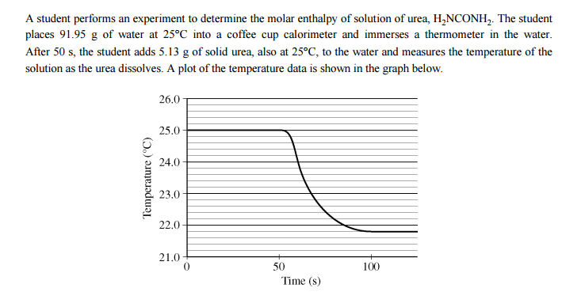
LO 5.3 Practice FRQ from 2010
Reveal Answer

Slide 9
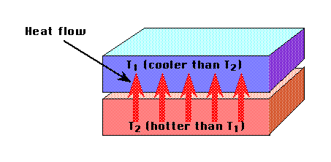
Heat Transfer
Source
Kinetic energy transferred between particles of varying temperature is heat energy.
Heat flows from particles of higher energy (hot) to those of lower energy (cold) when particles collide.
When the temperature of both particles are equal the substances are in thermal equilibrium.
Not all particles will absorb or release the same amount of heat per gram.
Specific Heat Capacity is a measure of the amount of heat energy in Joules that is absorbed to raise the temperature of 1 gram of a substance by 1 degree Kelvin.
Heat transfer can be measured q=mc_{p}∆T
Video
LO 5.3: The student can generate explanations or make predictions about the transfer of thermal energy between systems based on this transfer being due to a kinetic energy transfer between systems arising from molecular collisions.

Slide 10
LO 5.3 Practice FRQ continued from 2010
Reveal Answer

Slide 11
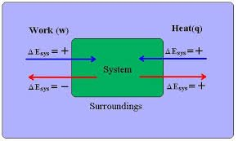
Conservation of Energy
Source
1st Law of Thermodynamics: Energy is conserved
Energy can be transferred as Work or Heat
∆E = q+w
Work = -P∆V (this is the work a gas does on the surroundings i:e the volume expanding a piston) a gas does no work in a vacuum.
Video
LO 5.4: The student is able to use conservation of energy to relate the magnitude of the energy changes occurring in two or more interacting systems, including identification of the systems, the type (heat vs. work), or the direction of the energy flow.

Slide 12
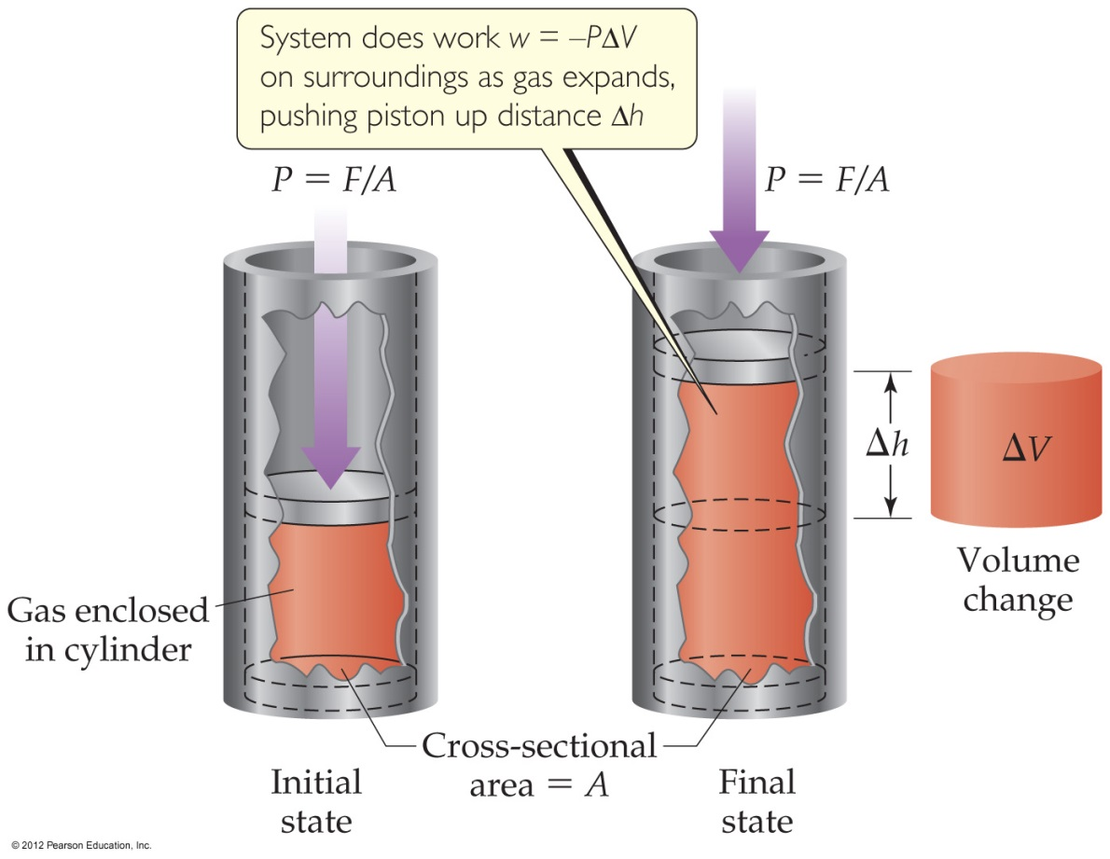
Conservation of Energy
Source
Video
Expansion/Compression of a gas
Volume increases, work is done by the gas
Volume decreases, work is done on the gas
LO 5.4: The student is able to use conservation of energy to relate the magnitude of the energy changes occurring in two or more interacting systems, including identification of the systems, the type (heat vs. work), or the direction of the energy flow.

Slide 13
Conservation of Energy when Mixing
Source
Energy is transferred between systems in contact with one another
Energy lost by one system is gained by the other so that total energy is always conserved.
-Q lost by system = +Q gained by surroundings
For example :
When room temperature water T1 (system) is mixed with cold water T2 (surroundings), the final temperature T3 will be in-between.
Q1 + Q 2 = 0 and energy is conserved
Video
LO 5.5: The student is able to use conservation of energy to relate the magnitudes of the energy changes when two non reacting substances are mixed or brought into contact with one another.

Slide 14
Calorimetry: an experimental technique used to determine the heat transferred in a chemical system. System can be a chemical reaction or physical process.
Source
Can use Calorimetry to solve for Heat Capacity of a calorimeter (C),, specific heat of a substance, (c), and ΔHvap, Δfus, ΔHrxn.
The data handling and math:
Law of Conservation of Energy: Q system + Qsurroundings = 0
Qsystem = - Qsurroundings where System = reaction, Surroundings = calorimeter
SO: Q rxn = - Q calorimeter
Heat Transfer due to Temperature Change in the Calorimeter:
Q= CΔT, or Q= mc ΔT where Q in J, C in J/K, m in g, c in J/g-K, ΔT in K
Q rxn = - Q calorimeter = - CΔT if the calorimeter Heat Capacity is Known, or can be determined.
Q rxn = - Q calorimeter = - mcΔT for reactions in solution.
When calculating ΔH, must take into account the mass of reactant that caused Q rxn.
Video
Example problem in video
LO 5.5: The student is able to use conservation of energy to relate the magnitudes of the energy changes when two non-reacting substances are brought into contact with one another.

Slide 15
LO 5.5 Practice FRQ from 2016
Reveal Answer

Slide 16
Chemical Systems undergo 3 main processes that change their energy: heating/cooling, phase transitions, and chemical reactions.
Source
1. Heat Transfer due to Temperature Change: (kJ)
Q= mcΔT
m= mass (g), c= specific heat capacity (J/g-°C), ΔT= Temp. change in °C
Q is + for Heating, - for cooling
2. Heat Transfer due to Phase Change: (kJ/mol )
Q= ΔH phase change
Q phase change = + for ΔH fusion, ΔH vaporizing, ΔH subliming, - for ΔH freezing, ΔH condensing, ΔH deposition
3. Q for a chemical reaction at constant pressure = ΔH rxn
When calculating ΔH rxn from Q, remember ΔH rxn must agree with the stoichiometric coefficients in the reaction. Units of ΔH rxn are kJ/mol rxn.
4. When a gas expands or contracts in a chemical reaction, energy is transferred in the form of Pressure- Volume work. W= -PΔV (l-atm)
Gas Expands – Does work on surroundings (system loses energy)
Gas Contracts – Work done on the gas (system gains energy) No change in volume, no work done.
Video
LO 5.6: The student is able to use calculations or estimations to relate energy changes associated with heating/cooling a substance to the heat capacity, relate the energy changes associated with a phase transition to the enthalpy of fusion/vaporization, relate energy changes associated with a chemical reaction to the enthalpy of the reaction, and relate the energy changes to PΔV work.

Slide 17
Calorimetry: an experimental technique used to determine the heat transferred in a chemical system. System can be a chemical reaction or physical process.
Source
Video
LO 5.7 The student is able to design and/or interpret the results of an experiment in which calorimetry is used to determine the change in enthalpy of a chemical process. (heating/cooling, phase transition, or chemical reaction) at constant pressure.

Slide 18
The net energy change during a reaction is the sum of the energy required to break the reactant bonds and the energy released in forming the product bonds. The net energy change may be positive for endothermic reactions where energy is required, or negative for exothermic reactions where energy is released.
Source
Any bond that can be formed can be broken. These processes are in opposition. (their enthalpy changes are equal in magnitude, opposite sign)
ΔH bonds breaking → ENDOTHERMIC (+)
ΔH bonds forming → EXOTHERMIC (-)
To find ΔHrxn, apply Hess’s Law:
ΔHrxn = ΣΔH bonds breaking (+) + Σ ΔH bonds forming (-)
To calculate or estimate ΔHrxn from Bond Energy:
Draw the Lewis Structure. Don’t forget about double and triple bonds!
Add up ΔH bonds breaking. It’s + (kJ)
Add up ΔH bonds forming. It’s - (kJ).
Add the two terms. Units are kJ/mol rxn.
To calculate ΔH°_{rxn} from a table of standard enthalpies of formation:
ΔH°_{rxn} = ΣΔH°_{f} products - ΣΔH°_{f} reactants
.
Video
If a reaction is EXOTHERMIC, there is a net release in energy, since weaker bonds break and stronger bonds form. Product has higher kinetic energy and lower potential energy than reactant.
If a reaction is ENDOTHERMIC, there is a net absorption of energy, since stronger bonds break, and weaker bonds form. Product has lower kinetic energy, and higher potential energy than reactant.
LO 5.8: The student is able to draw qualitative and quantitative connections between the reaction enthalpy and the energies involved in the breaking and formation of chemical bonds.

Slide 19
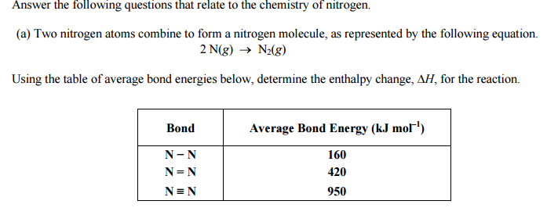
LO 5.8 Practice FRQ from 2003
Reveal Answer

Slide 20
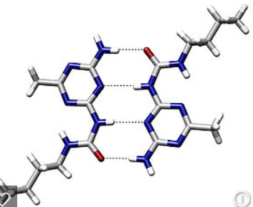
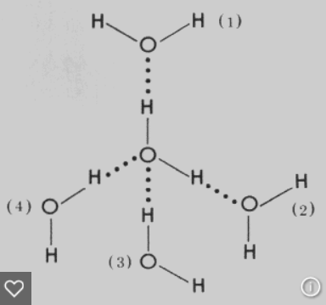
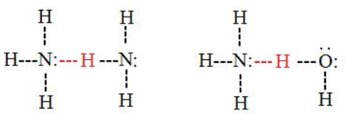
Electrostatic forces exist between molecules as well as between atoms or ions, and breaking these intermolecular interactions requires energy.
Source
The Stronger the IMF the more energy required to break it, the Higher the Boiling Point, the Lower the Vapor Pressure.
Intermolecular Forces Listed from weakest to strongest. Thus the boiling points and vapor pressure of molecular substances can be ordered based on IMF strength:
Dispersion (Induced Dipole- Induced Dipole): Caused by distortion of electron cloud. The larger the electron cloud, and the more surface area, the more polarizable the cloud, the stronger the dispersion force. Thus the boiling point trend in halogens is I₂ >Br₂>Cl₂> F₂ and n-butane (30.2° C) has a higher boiling point than isobutane (-11 °C). All substances have dispersion forces, as all electron clouds distort. Nonpolar molecules and atoms have only dispersion forces, as they have no permanent dipoles.
Dipole- Induced Dipole: Occurs between a polar molecule (HCl) and a nonpolar molecule. (Cl₂) The nonpolar molecule’s cloud distorts when affected by a dipole.
Dipole-Dipole: Occurs between 2 polar molecules. (HCl-HCl)
Hydrogen Bond: An extreme case of Dipole – Dipole. Occurs between molecules containing a H covalently bonded to F,O, or N. The “bond” occurs between the lone pair of F, O, or N, and the H which is attached to one of those elements.
Video
Weaker IMF, Lower Boiling, Higher Vapor Pressure
Stronger IMF, Higher Boiling, Lower Vapor Pressure
LO 5.9: Make claims and/or predictions regarding relative magnitudes of the forces acting within collections of interacting molecules based on the distribution of electrons within the molecules and the types of intermolecular forces through which the molecules interact.

Slide 21
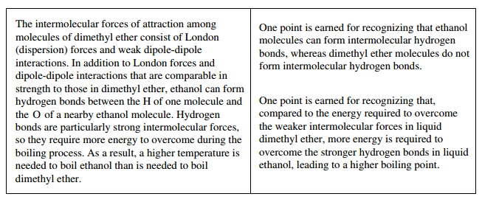
LO 5.9 Practice FRQ
Reveal Answer

Slide 22
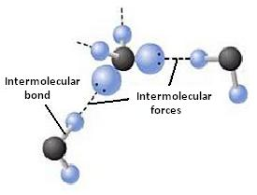
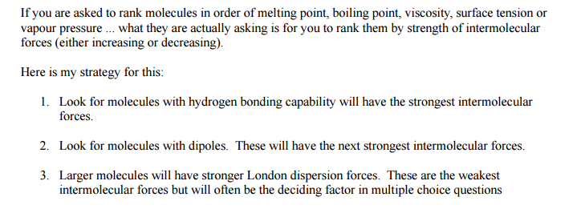
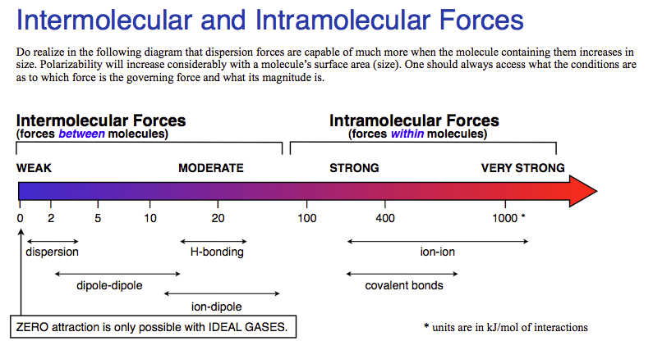
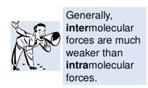
Inter vs Intra Chemical vs. Physical
Source
Source
Source
Source
Interstates- Between States
IMF- Between Molecules
Video
Note: this chart is only for comparing substances of similar sizes.
Chemical vs. Physical Changes
A physical change doesn’t produce a new substance. Phase changes are the most common. It involves IMF changes.
A chemical change produces new substances. Bonds are broken and new bonds are formed! The Intra-molecular forces are changed.
Strong IMF= High BP, High MP, High viscosity, high surface tension, low vapor pressure!
LO 5.10: The student can support the claim about whether a process is a chemical or physical change (or may be classified as both) based on whether the process involves changes in intramolecular versus intermolecular interactions.

Slide 23
LO 5.10 Practice FRQ from 2013

Slide 24
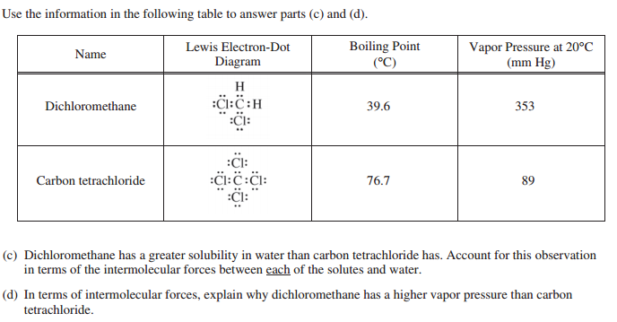
FRQ cont…

Slide 25
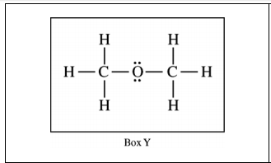
FRQ Answers 2013

Slide 26
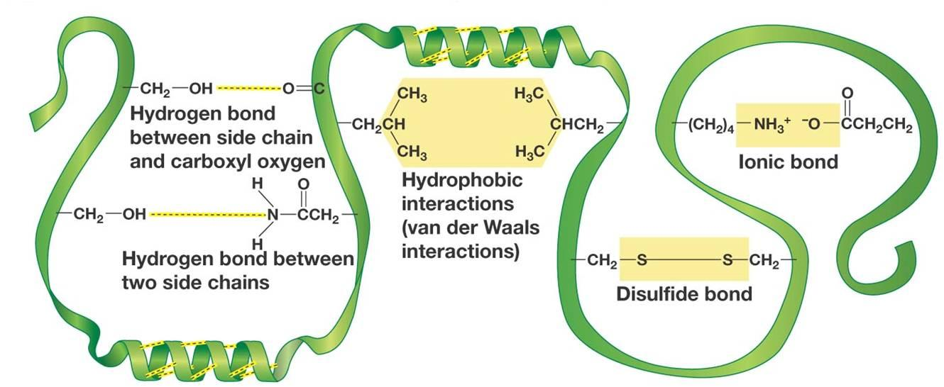
IMF and Biological/Large Molecules
Source
Source
Source
Video
LO 5.11: The student is able to identify the noncovalent interactions within and between large molecules, and/or connect the shape and function of the large molecule to the presence and magnitude of these interactions.

Slide 27
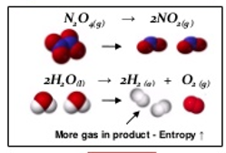
Entropy- Embrace the Chaos!
Source
Source
Entropy Changes that result in a + S:
Increasing moles
Increasing temperature
Increasing volume
Solid to liquid to gas
Forming more complicated molecules. (More moles of electrons)
Video
LO 5.12: The student is able to use representations and models to predict the sign and relative magnitude of the entropy change associated with chemical or physical processes.

Slide 28
LO 5.12 FRQ practice from 2006
Reveal Answer

Slide 29
Predicting How Reactions Will Go
Video #1
Video #2
Source
Entropy is typically given in J/K so you MUST convert to kJ!
LO 5.13: The student is able to predict whether or not a physical or chemical process is thermodynamically favored by determination of (either quantitatively or qualitatively) the signs of both delta Hº and delta Sº, and calculation or estimation of delta Gº when needed.

Slide 30
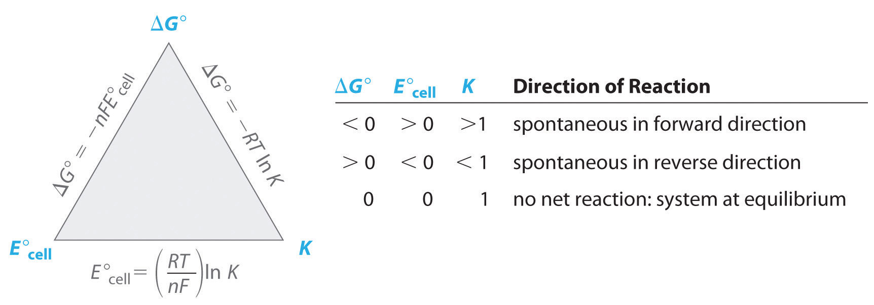
How can I calculate ΔG?
Source
Source
Video
Video
Video
ΔG$°=−nFE°$
LO 5.14: Determine whether a chemical or physical process is thermodynamically favorable by calculating the change in standard Gibbs free energy

Slide 31
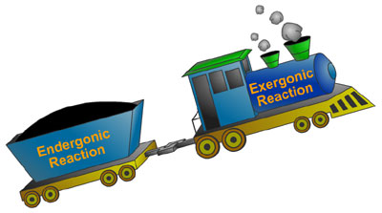
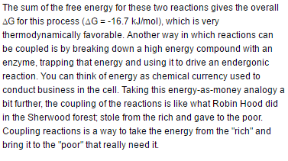
Coupling Reactions
Source
Video #1
ChooChoo
Exothermic Reaction
Endothermic Reaction
LO: 5.15 The student is able to explain the application the coupling of favorable with unfavorable reactions to cause processes that are not favorable to become favorable.

Slide 32
Source
Coupled Reactions and LeChatelier
Video
LO: 5.16 The student can use LeChatelier's principle to make qualitative predictions for systems in which coupled reactions that share a common intermediate drive formation of a product.

Slide 33
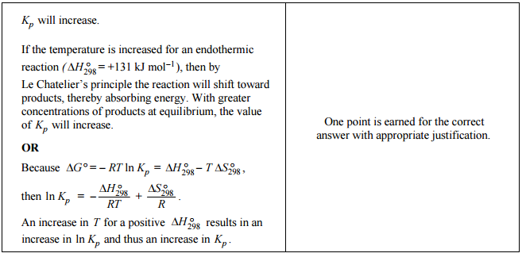
LO 5.16 FRQ Practice from 2009
Reveal Answer

Slide 34
COUPLING OF REACTIONS
Reactions with known values can be COUPLED to produce a new reaction.
When we couple reactions (or half-reactions), we may multiple by a factor or reverse the reaction before we couple or add them together.
Video
Coupled Reactions and K
Source
Source
Source
Manipulation | Equilibrium constants (K) | Free energy, enthalpy or entropy | Standard Reduction potential (Eº)
Multiply by factor | Raise K to power of factor | Multiply by factor | NOTHING!
Flip/reverse rxn | Inverse of K | Change sign | Change sign
Add Reactions | Multiply values | Add Values | Add values
LO 5.17: The student can make quantitative predictions for systems involving coupled reactions that share a common intermediate, based on the equilibrium constant for the combined reaction.

Slide 35
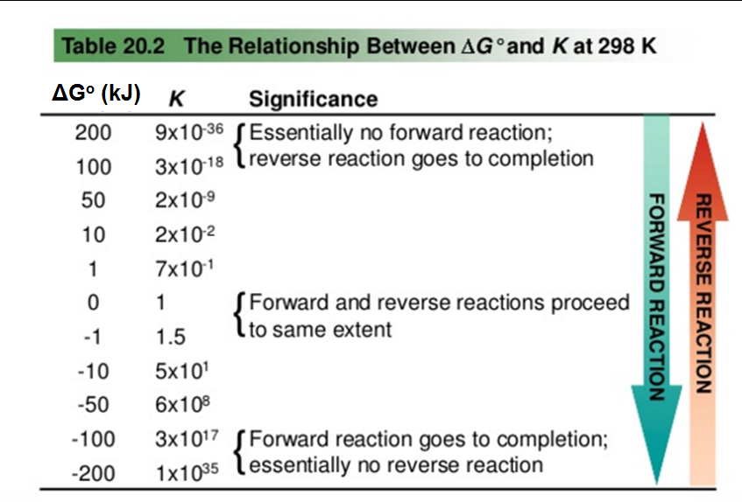
Is it thermo, kinetics, or K?
The free energy at non-standard, non-equilibrium states is given by:
At Equilibrium, ΔG = 0 and Q becomes “K”
Thermodynamically favorable (aka spontaneous) means a reaction is PRODUCT favored at a given temperature.
THERMODYNAMICALLY FAVORABLE
Kinetics tells us how FAST a reaction will proceed.
Equilibrium tells us how FAR a reaction proceeds.
Thermodynamics tells us whether or not the reaction is FAVORABLE at a given temperature.
A reaction that is thermodynamically favorable will form more products at equilibrium BUT the reaction may be so SLOW that few products form in a reasonable amount of time.
ΔGº and the Equilibrium Constant
Equilibrium constant | Description | Standard Gibbs Free Energy
K = 1 | Neither reactant nor product favored | ΔGº = 0
K > 1 | Product favored | ΔGº < 0 (thermodynamically favorable)
K < 1 | Reactant favored | ΔGº > 0 (thermodynamically unfavorable)
Video
ΔG ⁼ ΔGº + RTln(Q)
Source
Source
ΔGº = -RTln(K)
K > 1, ln(K) is positive, ΔGº is negative
ΔH
“Thermodynamically UNFAVORABLE” (aka non-spontaneous) reactions will run in reverse when set up with standard conditions (1M/1atm of ALL reactants and products) BUT can be made to proceed forward under different conditions. "
As K decreases, ΔGº becomes more positive
L 5.18: Explain why a thermodynamically favored chemical reaction may not produce large amounts of product (based on consideration of both initial conditions and kinetic effects), or why a thermodynamically unfavored chemical reaction can produce large amounts of product for certain sets of initial conditions.

Slide 36
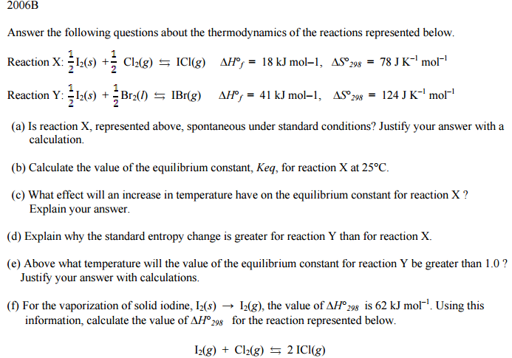
Practice FRQ for BI #5

Slide 37
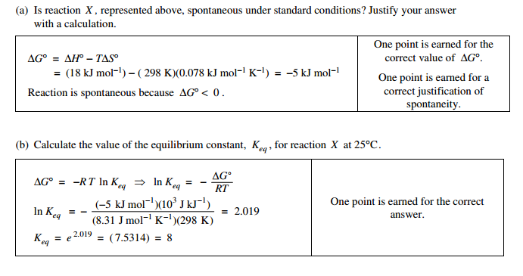
Answers to 2006 B

Slide 38
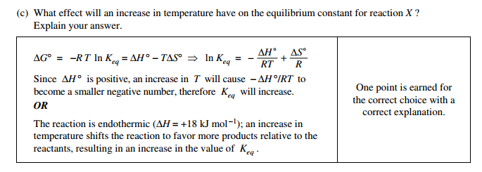
Answers cont…

Slide 39
Answers cont…

