Slide 1
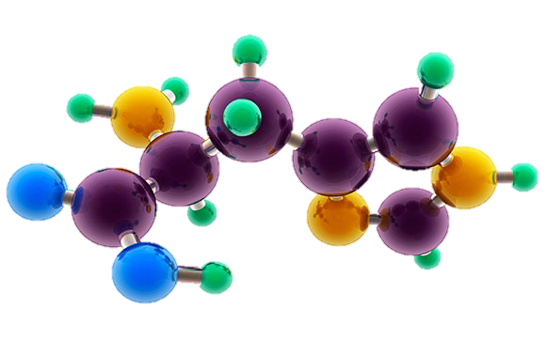
AP Chemistry Exam Review

Slide 2
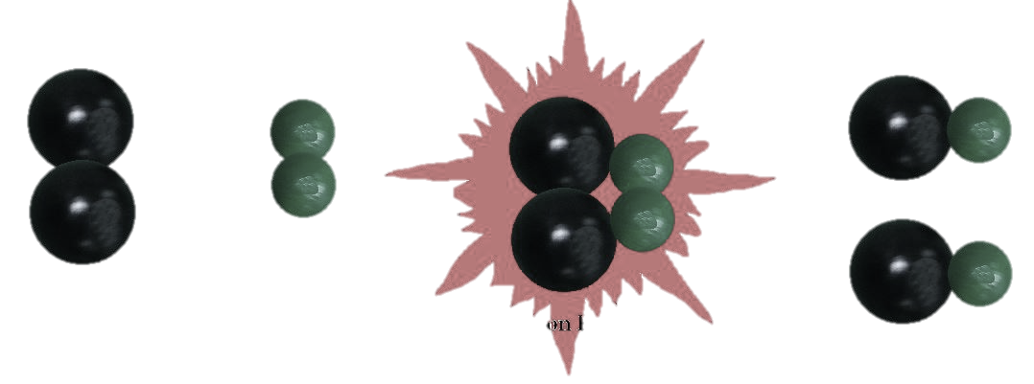
Big Idea #4
Kinetics

Slide 3
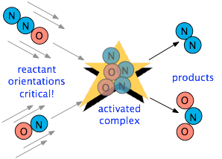
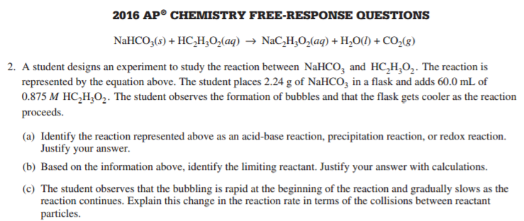
Factors Affecting Reaction Rate
Source
Factors that Affect Reaction Rate
State of reactants
Rate increases as state changes from solid → gas as increased molecular movement allows for more opportunity for collision
Greater surface area of solids will increase rate as more reactant is exposed and able participate in collisions
Temperature - more kinetic energy leads to more successful collisions between molecules
Concentration – more reactants → more collisions
Use of a catalyst – affect the mechanism of reaction leading to faster rate
Video
Collision theory states that reactants must collide in the correct orientation and with enough energy for the molecules to react; changing the number of collisions will affect the reaction rate
Rate is the change in concentration over time
Δ[A] / t
LO 4.1: The student is able to design and/or interpret the results of an experiment regarding the factors (i.e., temperature, concentration, surface area) that may influence the rate of a reaction.

Slide 4
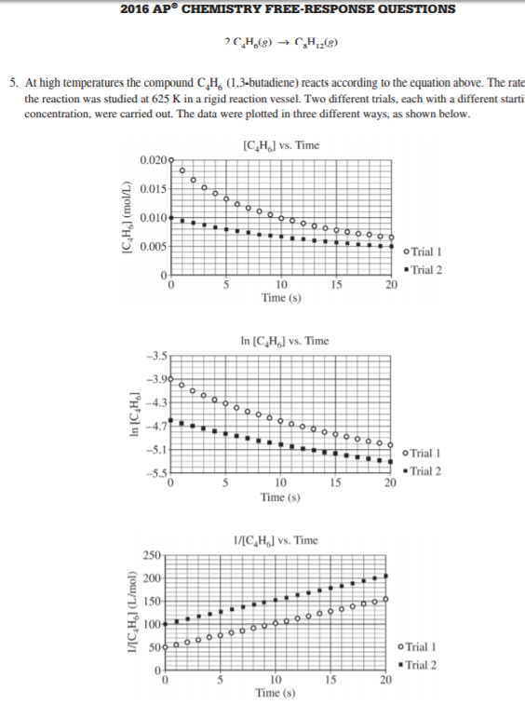
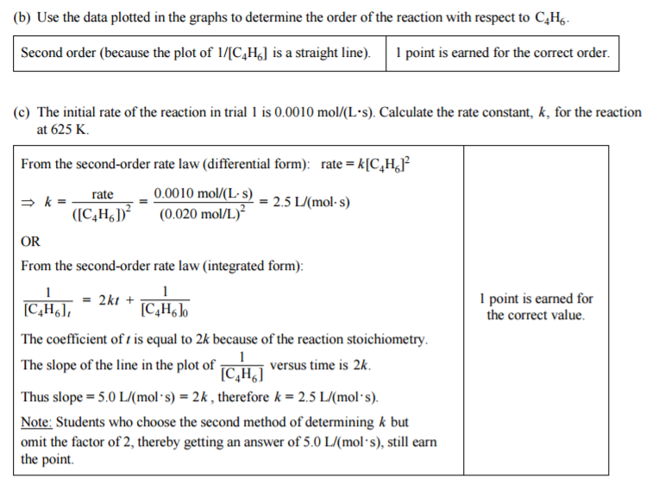
Determining Rate Order
Source
Rate law for a reaction has the form: rate = k [A]^{m}[B]^{n}… (only reactants are part of the rate law)
Exponents (m, n, etc. ) are determined from examining data, not coefficients:
for A + B → C
The overall rate expression for the reaction is rate = k [B]
k is the rate constant and is determined experimentally by plugging in data into the rate expression
When [A] is doubled, the rate do not change, so the reaction is zero order with respect to A
When [B] is doubled, the rate doubles, so the reaction is first order with respect to B
Trial | Initial [A] (mol/L) | Initial [B] (mol/L) | Initial Rate (mol/(L•s)
1 | 0.100 | 0.100 | 0.002
2 | 0.200 | 0.100 | 0.002
3 | 0.200 | 0.200 | 0.004
Video
Plot to create a straight line graph:
Zeroth Order First Order Second Order
[A] / Time ln[A] / Time 1/[A] / time
The first and second order integrated rate laws can be found on the Kinetics section of the AP Equations Sheet
LO 4.2: The student is able to analyze concentration vs. time data to determine the rate law for a zeroth-, first-, or second-order reaction.

Slide 5
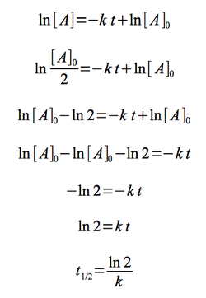
Half-life (First Order)
Source
Time needed for the concentration of reactant to reach half its initial value
Time to reach half concentration is dependent on k, not initial concentration
Half life remains constant in a first order reaction
Example: when t_{1/2}= 30 sec, the concentration is halved each 30 seconds
Video
The first order half life equation is derived from the first order integrated rate law
Initial Conditions After 30 seconds After 60 seconds
(12 molecules) (6 molecules) (3 molecules)
LO 4.3: The student is able to connect the half-life of a reaction to the rate constant of a first-order reaction and justify the use of this relation in terms of the reaction being a first-order reaction.

Slide 6
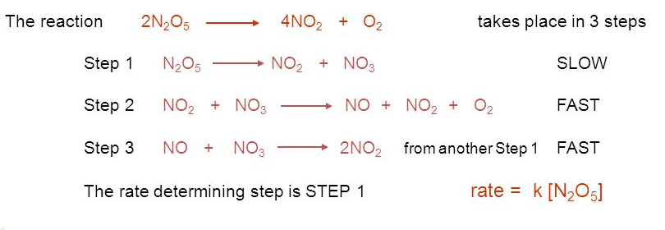
Collision Theory and Reaction Mechanisms
Source
In a successful collision
Molecules have enough energy to overcome E_{a.}
Molecules collide with proper orientation to break the bonds.
In a Mechanism
The rate law of any elementary reaction can be written from its stoichiometry.
The rate law of the slow step is the rate law of the overall reaction.
The larger the rate constant, the larger the percentage of molecules having successful collisions.
Video
Click here after you identify the rate determining step AND have written the rate law
LO: 4.4: Connect the rate law for an elementary reaction to the frequency/success of molecular collisions, including connecting the frequency and success to the order and rate constant.

Slide 7
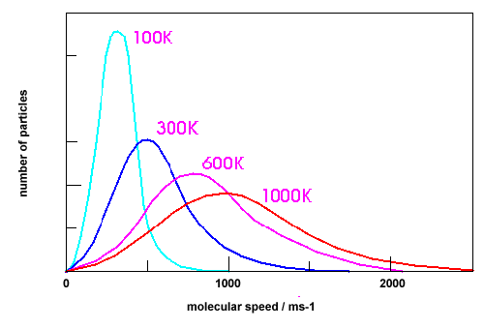
Successful and Unsuccessful Molecular Collisions
Source
Assume that all of these curves show the distribution of molecular speeds for the same substance.
Video
A
Curve D because a larger number of its particles have higher kinetic energies, and so are more likely to overcome the activation energy barrier when they collide.
Click here after you have chosen the correct curve and justified your answer.
B
C
D
Question: Which curve indicates the particles most likely to produce collisions that result in a chemical change? Justify your selection.
LO 4.5: The student is able to explain the difference between collisions that convert reactants to products and those that do not in terms of energy distributions and molecular orientation.

Slide 8
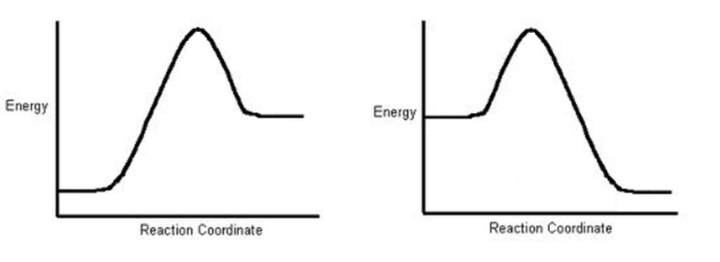
Temperature and Reaction Rate
Source
Video
Reaction A
Reaction B
In order for both Reaction A and Reaction B to proceed in the forward direction at the same rate, which reaction would need to be at the higher temperature? Justify your choice.
Click here to see answer and justification.
The greater the activation energy, the slower the reaction. Since Reaction A has a greater activation energy, it should be slower than Reaction B at the same temperature. To bring its rate up to that of Reaction B would require increasing its temperature. Important note: It does not matter at all, in answering this question, that Reaction A is endothermic and Reaction B is exothermic.
LO 4.6: The student is able to use representations of the energy profile for an elementary reaction (from the reactants, through the transition state, to the products) to make qualitative predictions regarding the relative temperature dependence of the reaction rate.

Slide 9
Reaction Mechanisms
Source
X₂ + Y₂ → X₂Y₂ rate = k[X₂]
A reaction and its experimentally determined rate law are represented above. A chemist proposes two different possible mechanisms for the reaction, which are given below.
Mechanism 1 Mechanism 2
X₂ → 2X (slow) X₂ → 2X (slow)
X + Y₂ → XY₂ (fast) X + Y₂ → XY + Y (fast)
X + XY₂ → X₂Y₂ (fast) X + XY → X₂Y (fast)
X₂Y + Y → X₂Y₂ (fast)
Based on the information above, which of the mechanisms is/are consistent with the rate law? List the intermediates in each mechanism:
Video
Answer: Both are consistent. In both mechanisms, the molecularity of the slow, rate determining step is consistent with the rate law. Furthermore, the sum of the elementary steps for both mechanisms gives the overall balanced equation for the reaction.
Intermediates in mechanism 1: X, XY2. Intermediates in mechanism 2: X, XY, Y, X2Y
LO 4.7: Evaluate alternative explanations, as expressed by reaction mechanisms, to determine which are consistent with data regarding the overall rate of a reaction, and data that can be used to infer the presence of a reaction intermediate.

Slide 10
Reaction Mechanisms
Source
The rate law for a reaction is found to be Rate = k[A]²[B]. What is the intermediate? Which of the following mechanisms gives this rate law?
I. A + B ⇄ E (fast)
E + B → C + D (slow)
II. A + B ⇄ E (fast)
E + A → C + D (slow)
III. A + A → E (slow)
E + B → C + D (fast)
A. I
B. II
C. III
D. Two of these
Video
Answer: E is the intermediate. Only Mechanism II is consistent with the rate law. Whenever a fast equilibrium step producing an intermediate precedes the slow rate determining step and we want to remove the intermediate from the rate law, we can solve for the concentration of the intermediate by assuming that an equilibrium is established in the fast step. The concentration of the intermediate in the rate determining slow step can be replaced with an expression derived from the equilibrium constant [E] =K_{eq}[A][B]. This substitution gives us the desired rate law: rate = k’[A]²[B]
LO 4.7 The student is able to evaluate alternative explanations, as expressed by reaction mechanisms, to determine which are consistent with data regarding the overall rate of a reaction, and data that can be used to infer the presence of a reaction intermediate.

Slide 11
Draw and label axes for the energy profiles below. Match the curves with the appropriate description.
Reaction Mechanisms and Energy Profiles – Practice Problem
exothermic reaction with a 2 step mechanism where the first step is slow. | endothermic reaction with a 2 step mechanism where the first step is slow.
endothermic reaction with a 2 step mechanism where the second step is slow. | exothermic reaction with a 1 step mechanism.
exothermic reaction with a 2 step mechanism where the second step is slow. | endothermic reaction with a 1 step mechanism.
D
C
F
Potential Energy
Potential Energy
Potential Energy
Reaction pathway
Reaction pathway
Reaction pathway
E
B
A
Potential Energy
Potential Energy
Potential Energy
Reaction pathway
Reaction pathway
Reaction pathway
LO 4.7 Cont. Dena K. Leggett, PhD Advanced Chemistry Teacher Allen High School Copyright 2015

Slide 12
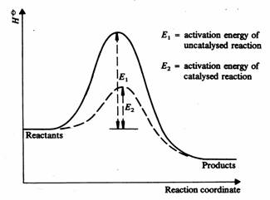
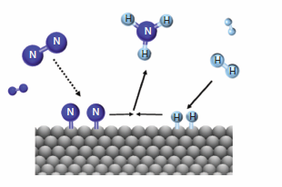
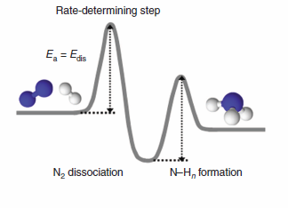
Catalysts
Source
A catalyst can stabilize a transition state, lowering
the activation energy.
A catalyst can participate in the formation of a new reaction intermediate,
providing a new reaction pathway.
Video
The rate of the Haber process for the synthesis of ammonia is increased
by the use of a heterogeneous catalyst which provides a lower energy pathway.
N₂(g) + 2H₂ (g) → iron-based catalyst + 2NH₃ (g)
Iron based catalyst
LO 4.8 The student can translate among reaction energy profile representations, particulate representations, and symbolic representations (chemical equations) of a chemical reaction occurring in the presence and absence of a catalyst.

Slide 13
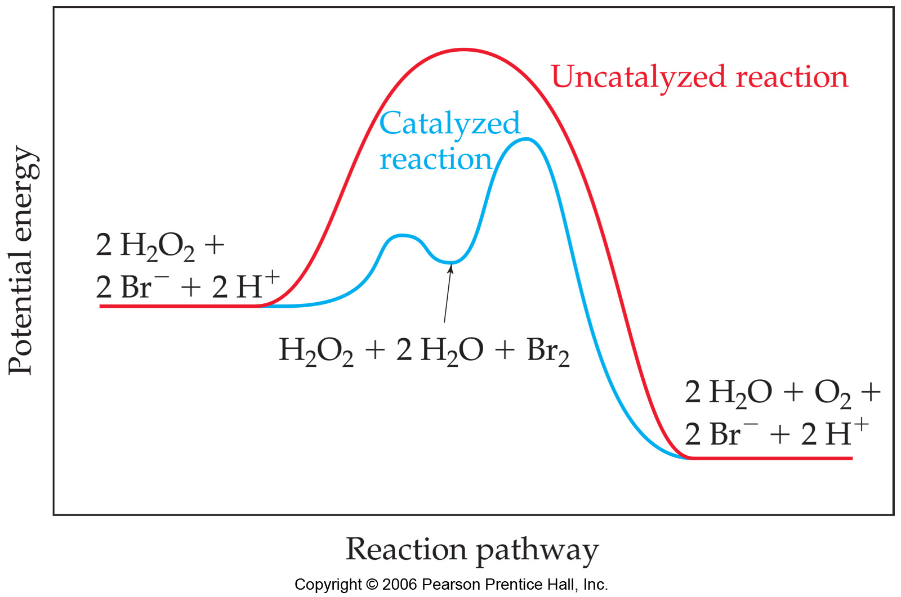
Catalysts
Source
catalysts provide alternative mechanisms with lower activation energy
In acid-base catalysis, a reactant either gains or loses a proton,
changing the rate of the reaction.
b. In surface catalysis, either a new reaction intermediate is formed or the probability of successful collisions is increased.
Video
c. In Enzyme catalysis enzymes bind to reactants in a way that lowers the activation energy. Other enzymes react to form new reaction intermediates.
Homogeneous catalysis
of the decomposition of H2O2
LO 4.9 The student is able to explain changes in reaction rates arising from the use of acid-base catalysts, surface catalysts, or enzyme catalysts, including selecting appropriate mechanisms with or without the catalyst present.

