Slide 1
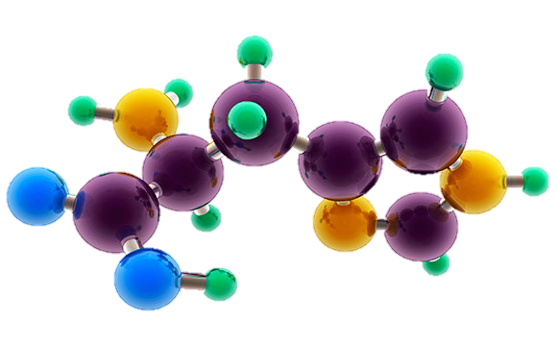
AP Chemistry Exam Review

Slide 2
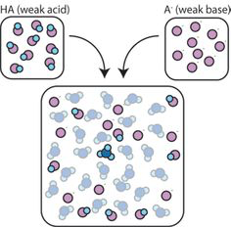
Big Idea #6
Equilibrium

Slide 3
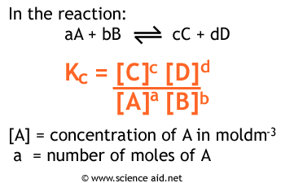
What is chemical equilibrium?
Source
Systems that have reached the state where the rates of the forward reaction and the reverse reaction are constant and equal.
It is a dynamic process where reactants continuously form products and vice versa, but the net amounts of reactants and products remain constant.
The proportions of products and reactants formed in a system at a specific temperature that has achieved equilibrium is represented by K, the equilibrium constant.
Video
LO 6.1: Given a set of experimental observations regarding processes that are reversible, construct an explanation that connects the observations to the reversibility of the underlying chemical reactions or processes.

Slide 4
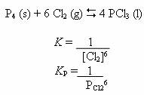
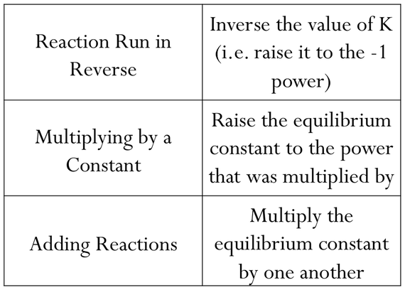
Manipulating Q and K
Source
K (equilibrium constant) represents the relative amounts of products to reactants at equilibrium at a given temperature.
Q (reaction progress) describes the relative amounts of products to reactants present at any point in the reaction at a given temperature.
Q and K only include substances that are gases or in aqueous solutions. No solids or liquids are ever included in these expressions.
Video
Similar reactions will have related K values at the same temperature.
Click reveals answer.
.35
LO 6.2: The student can, given a manipulation of a chemical reaction or set of reactions (e.g., reversal of reaction or addition of two reactions), determine the effects of that manipulation on Q or K.

Slide 5
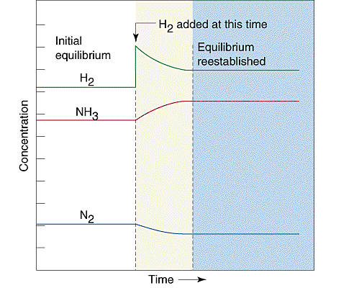
Kinetics and Equilibrium
Source
Kinetics examines the rate at which reactions proceed. Rate laws are used to describe how reactant concentrations affect a reaction’s rate. Rate constants (k) in rate law expressions are determined experimentally at a given temperature.
Equilibrium describes the state at which the rates of the forward reaction and the reverse reaction are constant and equal.
If the rates are initially unequal (the system is not at equilibrium), the faster direction depletes its reactants, which feeds back to slow down that direction.
At the same time, the slower direction accumulates its reactants, speeding up the slower direction.
Video
These loops continue until the faster rate and the slower rate have become equal.
In the graph to the right, after equilibrium has been achieved, additional hydrogen gas is added to the system. The system then consumes both H₂ and N₂ to form additional NH₃ molecules, eventually reestablishing equilibrium.
LO 6.3: The student can connect kinetics to equilibrium by using reasoning, such as LeChatelier’s principle, to infer the relative rates of the forward and reverse reactions.

Slide 6
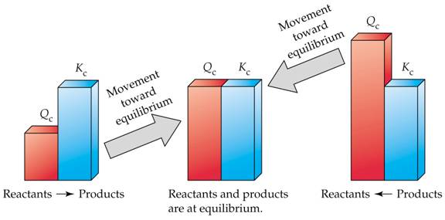
Q vs. K
Source
Equilibrium is reacted when the rates of the forward reaction and the rates of the reverse reaction are equal, which is when Q is equal to K.
Comparing Q to K enables us to determine if a chemical system has achieved equilibrium or will need to move towards reactants or products to reach equilibrium.
- if Q < K, the reaction will proceed in the forward direction until Q = K - if Q > K, the reaction will proceed in the reverse direction until Q = K - if Q = K, the reaction is at equilibrium, and the concentrations of reactants and products remain constant
Video
LO 6.4: Given a set of initial conditions and the equilibrium constant, K, use the tendency of Q to approach K to predict and justify the prediction as to whether the reaction will proceed toward products or reactants as equilibrium is approached.

Slide 7
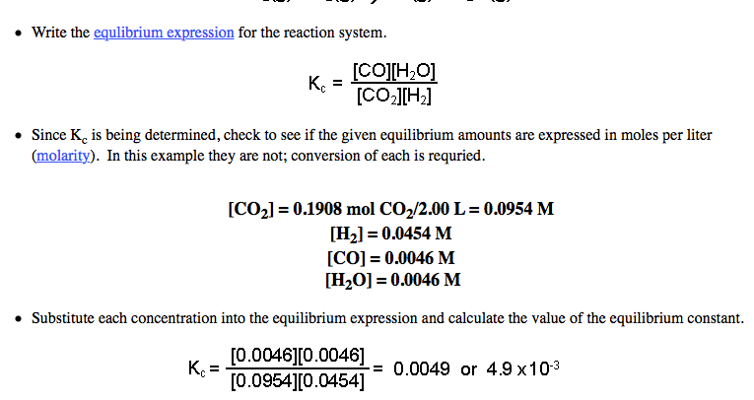
Calculating K
Source
Source
Equilibrium constants can be determined using experimental concentrations of reactants and products at equilibrium.
Steps: 1) Write an equilibrium expression 2) Determine equilibrium molar concentrations or partial pressures for all substances in expression 3) Substitute quantities into equilibrium expression and solve.
Video
Example: Calculate K for the following system if 0.1908 mol CO₂, 0.0908 mol H₂, 0.0092 CO, and 0.0092 mol H₂O vapor are present in a 2.00 L vessel at equilibrium:
Click reveals answer and explanation.
LO 6.5: The student can, given data (tabular, graphical, etc.) from which the state of a system at equilibrium can be obtained, calculate the equilibrium constant, K.

Slide 8
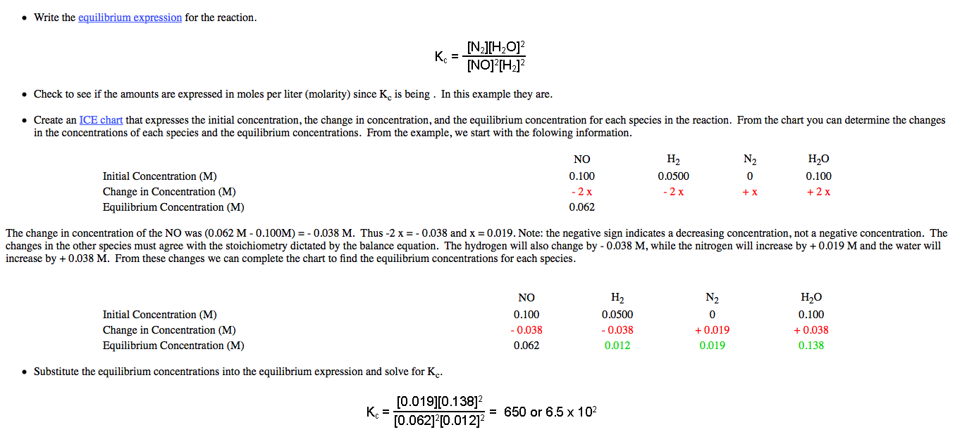
Calculating K
Source
Source
Equilibrium constants can also be determined from both initial and equilibrium concentrations using an ICE chart.
Steps: 1) Write an equilibrium expression 2) Determine molar concentrations or partial pressures for all substances in expression 3) Determine equilibrium concentrations or partial pressures using an ICE chart. 4) Substitute quantities into equilibrium expression and solve.
Video
Example: Initially, a mixture of 0.100 M NO, 0.050 M H2, and 0.100 M H2O was allowed to reach equilibrium. No N2 was present initially. At equilibrium, NO had a concentration of 0.062 M. Determine the value of K for the reaction:
Click reveals answer and explanation.
LO 6.5: Given data (tabular, graphical, etc.) from which the state of a system at equilibrium can be obtained, calculate the equilibrium constant, K.

Slide 9
Calculating Equilibrium Concentrations with K
Source
Equilibrium concentrations can be calculated using a K expression, the K constant, and initial concentrations or partial pressures of substances.
Steps: 1) Write an equilibrium expression for the reaction 2) Set up an ICE table and fill in “initial” quantities 3) Determine “changes” in the system in terms of x needed for the system to achieve equilibrium 4) Determine the “equilibrium” values for the system by adding the “initial” and “change” values together 5) Solve for x using the K expression and the “equilibrium” values. Verify if the change in initial concentrations is negligible using the 5% rule. 6) Determine all equilibrium quantities using the value of x
Example: Given the following reaction at 1373 K: Cl₂(g) 2Cl(g), determine the equilibrium partial pressures of all species if 0.500 atm Cl₂ is present initially. K = 1.13x10⁻⁴ for the reaction at 1373 K.
Video
Click reveals answer.
0.497 atm Cl₂ and
0.00752 atm Cl
LO 6.6: Given a set of initial conditions (concentrations or partial pressures) and K, use stoichiometric relationships and the law of mass action (Q equals K at equilibrium) to determine qualitatively and/or quantitatively the conditions at equilibrium for a system involving a single reversible reaction.

Slide 10
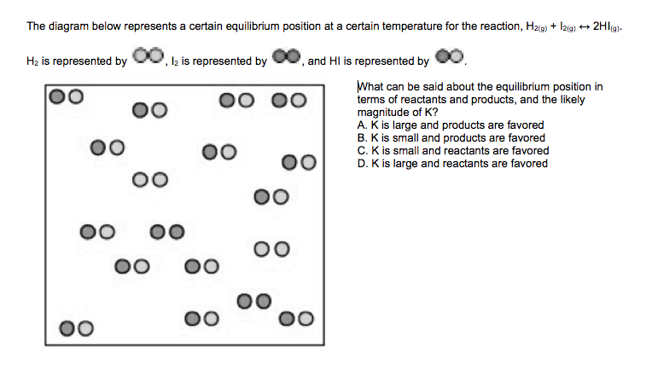
Magnitude of K
Source
For many reactions involving aqueous solutions, K is either very large (favoring the forward reaction) or very small (favoring the reverse reaction)
The size of K can be used to describe the relationship between the numbers of reactant and product particles present at equilibrium.
Video
LO 6.7: The student is able, for a reversible reaction that has a large or small K, to determine which chemical species will have very large versus very small concentrations at equilibrium.

Slide 11
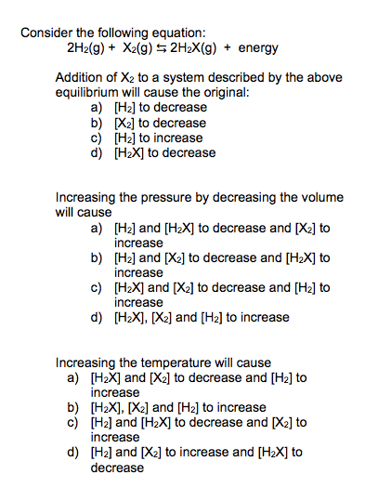
Le Chatelier’s Principle
Animation
Source
This principle is used to describe changes that occur in a system that has achieved equilibrium. There are three factors that can cause shifts in a system at equilibrium: concentration, pressure, and temperature.
Change | Direction System Shifts to Reestablish Equilibrium
Adding a reactant | Shifts towards products
Adding a product | Shifts towards reactants
Removing a reactant | Shifts towards reactants
Removing a product | Shifts towards products
Increasing pressure (decreasing volume) | Shifts toward less gas molecules
Decreasing pressure (increasing volume) | Shifts towards more gas molecules
Adding an inert gas | No effect
Increasing the temperature | Endothermic: shifts towards products Exothermic: shifts towards products
Decreasing the temperature | Endothermic: shifts towards reactants Exothermic: shifts towards products
Video
LO 6.8: The student is able to use LeChatelier’s principle to predict the direction of the shift resulting from various possible stresses on a system at chemical equilibrium.

Slide 12
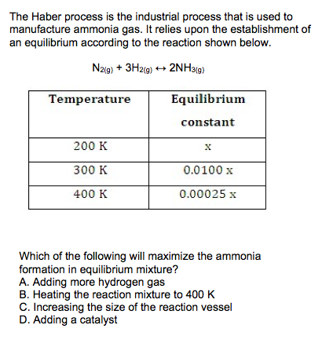
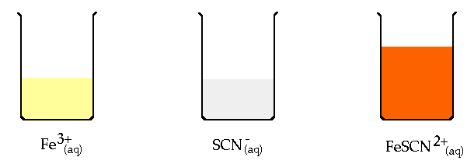
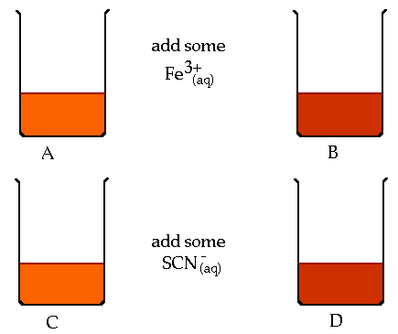
Experimentally Examining Le Chatelier’s Principle
Animation
Source
Systems at equilibrium can be examined using Le Chatelier’s Principle by measuring its properties, including pH, temperature, solution color (absorbance)
Video
Fe⁺³(aq) + SCN⁻(aq) FeSCN²⁺(aq)
LO 6.9: The student is able to use LeChatelier’s principle to design a set of conditions that will optimize a desired outcome, such as product yield.

Slide 13
Changes to Q and K for a System at Equilibrium
Animation
Some changes that occur to a system at equilibrium will affect the reaction’s current position (Q). Others will affect the value of K
Change | Direction System Shifts to Reestablish Equilibrium | Effect on Q or K
Adding a reactant | Shifts towards products | Q decreases
Adding a product | Shifts towards reactants | Q increases
Removing a reactant | Shifts towards reactants | Q increases
Removing a product | Shifts towards products | Q decreases
Increasing pressure (decreasing volume) | Shifts toward less gas molecules | Q can increase, decrease, or remain constant depending on ratio of gas molecules between reactants and products
Decreasing pressure (increasing volume) | Shifts towards more gas molecules
Adding an inert gas | No effect | Q doesn’t change
Increasing the temperature | Endothermic: shifts towards products Exothermic: shifts towards reactants | Endothermic: K increases Exothermic: K decreases
Decreasing the temperature | Endothermic: shifts towards reactants Exothermic: shifts towards products | Endothermic: K decreases Exothermic: K increases
Video
Source
LO 6.10: The student is able to connect LeChatelier’s principle to the comparison of Q to K by explaining the effects of the stress on Q and K.

Slide 14
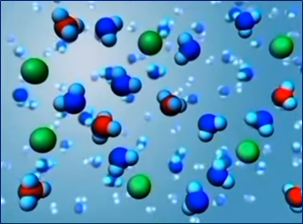
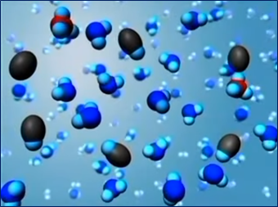
Acid/Base Particulates
Source
Select Acid-Base Ionization
Video
Strong: Since K_{a} = $\frac{\left[H3O˖\right][A˗]}{[HA]}$>>1, at equilibrium strong acids are molecules that essentially ionize to completion in aqueous solution, disassociating into H₃O⁺ ions and the additional anion.
Weak: Since K_{a} = $\frac{\left[H3O˖\right][A˗]}{[HA]}≪$1, at equilibrium weak acids are molecules that only partially ionize in aqueous solution, disassociating into few H₃O⁺ ions and the additional anion.
LO 6.11: The student can generate or use a particulate representation of an acid (strong or weak or polyprotic) and a strong base to explain the species that will have large versus small concentrations at equilibrium.

Slide 15
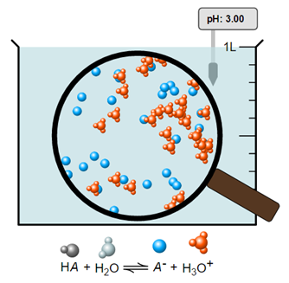
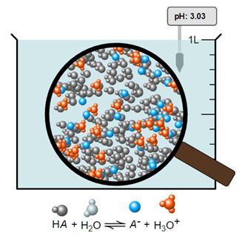
pH of Weak or Strong Acid
Source
Note the similar pH values of both monoprotic acids.
pH= 3.00
pH= 3.00
Video
This is a particulate picture of a weak acid whose [HA] = 1.00M and K_{a} = 1.00x10⁻⁶.
pH is a measure of the [H⁺] in solution. More moles of a weak acid are needed to achieve equivalent [H⁺] values of a strong acid of the same pH, since a weak acid only partially ionizes.
This is a particulate picture of a strong acid whose [HA] = 0.00100M.
Note the 100% ionization of this acid.
If similar volumes of both acids above were titrated with the same strong base, the weak acid would require a larger volume of base to reach its equivalence point.
LO 6.12: Reason about the distinction between strong and weak acid solutions with similar values of pH, including the percent ionization of the acids, the concentrations needed to achieve the same pH, and the amount of base needed to reach the equivalence point in a titration.

Slide 16
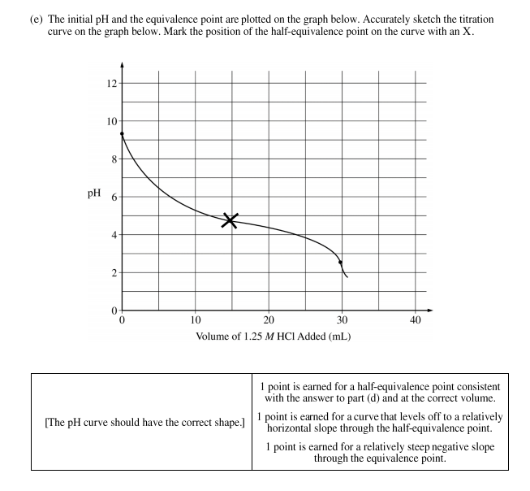
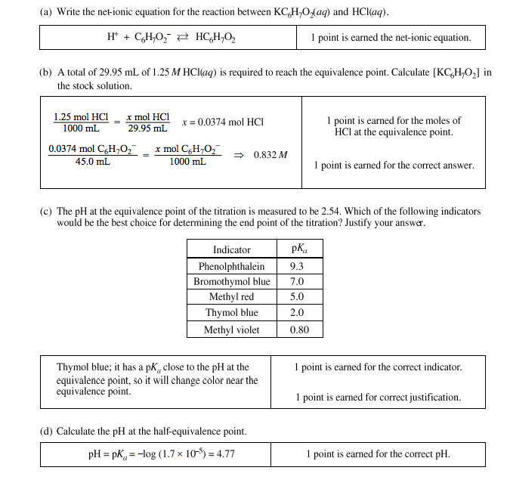
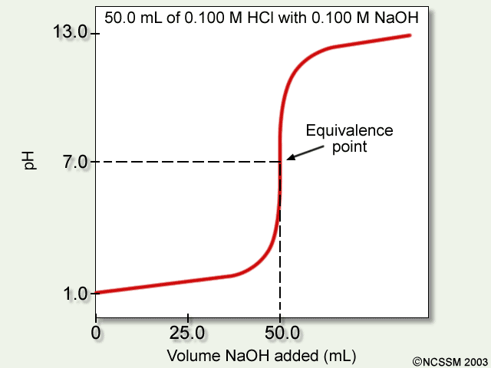
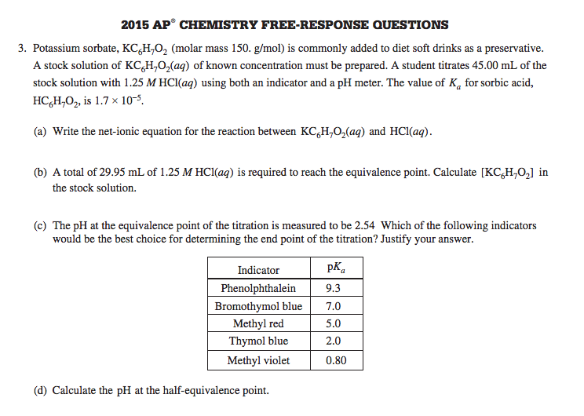
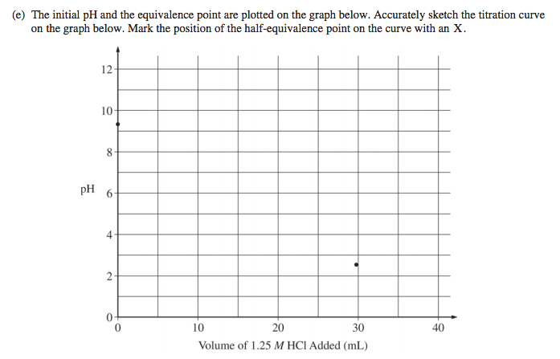
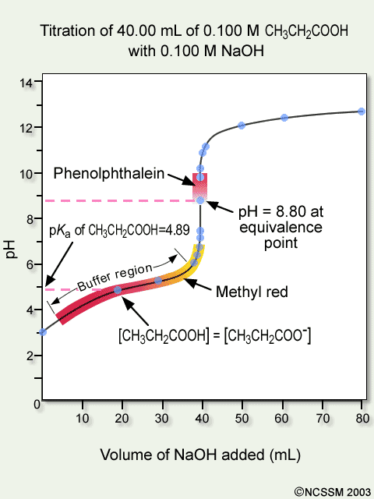
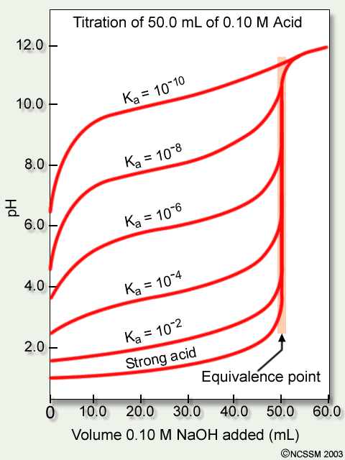
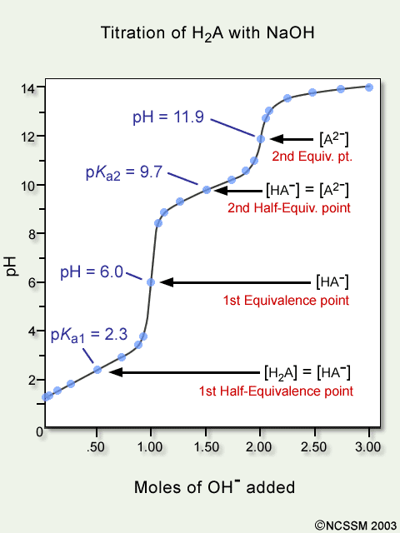
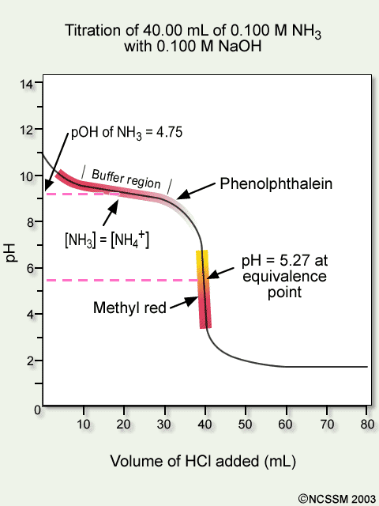
Titrations
Source
This illustration shows the titration curve of a strong acid with a strong base.
Video
This illustration shows the titration curve of a weak acid with a strong base with indicator changes.
This illustration shows the titration curves of several weak acids with a strong base
See Source link to review titration calculations.
This illustration shows the titration curve of a weak base with a strong acid with indicator changes.
This illustration shows the titration curve of a polyprotic weak acid with a strong base.
LO 6.13: The student can interpret titration data for monoprotic or polyprotic acids involving titration of a weak or strong acid by a strong base (or a weak or strong base by a strong acid) to determine the concentration of the titrant and the pK_{a} for a weak acid, or the pK_{b} for a weak base.

Slide 17
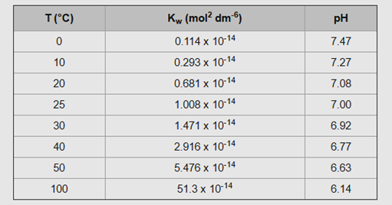
K_{w} and Temperature
Source
Video
E +
As T increases, pH of pure water decreases. The water is NOT becoming more acidic. A solution is only acidic if [H+] > [OH-].
At 50°C, the pH of pure water is 6.63, which is defined as “neutral”, when [H⁺] = [OH⁻]. A solution with a pH of 7 at this temperature is slightly basic b/c it is higher than the neutral value of 6.63.
The dissociation of water is endothermic. An increase of energy will shift the reaction to the right, increasing the forward reaction, and increase the value of K_{w}.
LO 6.14: The student can, based on the dependence of K_{w} on temperature, reason that neutrality requires [H⁺] = [OH⁻] as opposed to requiring pH = 7, including especially the application to biological systems.

Slide 18
Acid/Base Mixtures and its pH
Source
A 25 mL sample of hydrofluoric acid (HF) is titrated with 25 mL of 0.30M sodium hydroxide (NaOH). At the equivalence point of the titration, what would the pH of the solution be? Justify with a reaction.
pH < 7
pH = 7
pH > 7
pH = pK_{a}
Video
Click reveals answer and explanation.
The correct answer is “c” pH>7. At the equivalence point, the moles of acid equal the moles of base. The remaining species would be Na⁺ and F⁻. The conjugate base, F⁻ will hydrolyze with water, producing OH⁻ in solution: F⁻(aq) + H₂O(l)  HF(aq) + OH⁻(aq) Select the Source link to see more calculations in this titration.
LO 6.15: The student can identify a given solution as containing a mixture of strong acids and/or bases and calculate or estimate the pH (and concentrations of all chemical species) in the resulting solution.

Slide 19
pH and Acid/Base Equilibria
Source
1st click reveals answer and explanation.
See Source link for more calculations.
1. Vinegar is 0.50M acetic acid, HC₂H₃O_{2,} with a K_{a} = 1.8 x 10⁻⁵. What would be the pH of this solution?
Video
2. Identify and compare the relative strengths of the two acids and the two bases in this neutralization reaction: OH⁻(aq) + NH₄⁺(aq)  H₂O(l) + NH₃(aq).
The correct formulation of acid strength is based on a comparison to the K_{a}'s of hydronium (=1) and water (= 1 x 10⁻¹⁴). Any acid that is stronger than hydronium (e.g. HCl) is a strong acid and its conjugate base (chloride) has no effect on pH because it does not hydrolyze in water. Any acid whose strength is between hydronium and water (e.g. ammonium) is a weak acid, and its conjugate is a weak base. Similarly, for bases, any base with K_{b} greater than that of hydroxide, which is = 1, (e.g., oxide ion as K₂O) is a strong base, and its conjugate acid (K⁺) has no effect on pH because it does not hydrolyze in water. Any base with K_{b} between that of hydroxide and water (= 1 x 10⁻¹⁴) is a weak base, and its conjugate is a weak acid (e.g., acetate).
2nd click reveals answer and explanation.
Answer: Hydroxide(OH⁻), and ammonia(NH₃) are the two bases, with ammonia being the weaker, while ammonium(NH₄⁺) and water are the acids, with water the weaker.
LO 6.16: The student can identify a given solution as being the solution of a monoprotic weak acid or base (including salts in which one ion is a weak acid or base), calculate the pH and concentration of all species in the solution, and/or infer the relative strengths of the weak acids or bases from given equilibrium. concentrations.

Slide 20
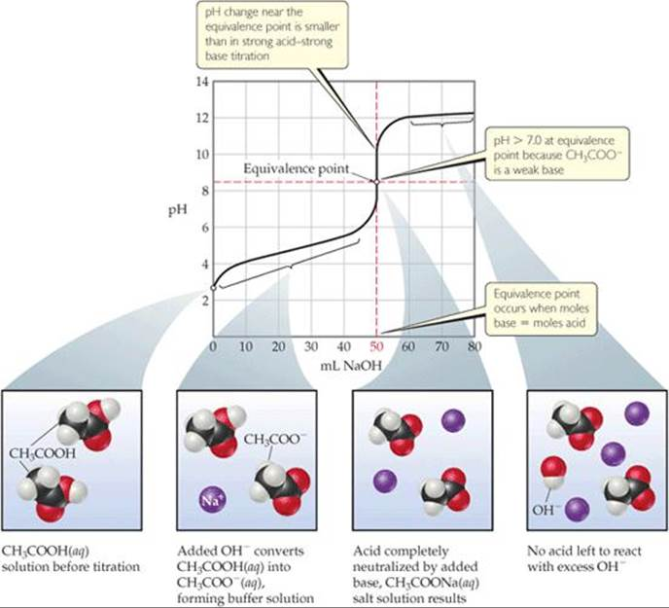
Acid/Base reaction species
Source
Ask yourself:
Is it strong? Weak? A salt? A buffer? What will it do in water?
See Source link for more details
Video
Deal w/strong A/B first. These will react to completion with the available species.
LO 6.17: The student can, given an arbitrary mixture of weak and strong acids and bases (including polyprotic systems), determine which species will react strongly with one another (i.e., with K>1) and what species will be present in large concentrations at equilibrium.

Slide 21
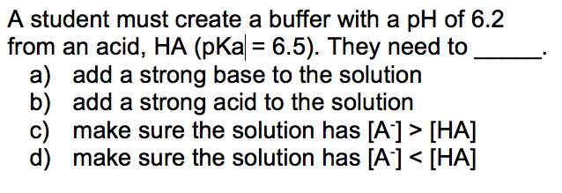
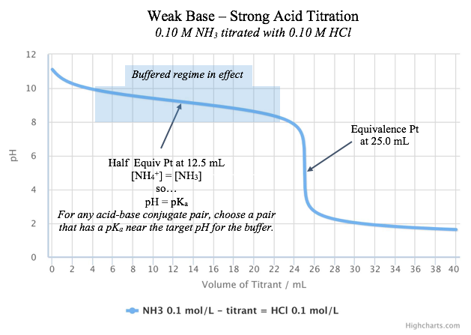
How to Build a Buffer:
Source
Estimating Buffer Capacity:
A buffer is only effective as long as it has sufficient amounts of both members of the conjugate acid-base pair to allow equilibrium to shift during a stress.
Getting the pH correct:
The pH of a buffer is primarily determined by the pKa of the weak acid in the conjugate acid-base pair.
When both species in the conjugate acid-base pair have equal concentrations, the pH of the buffer is equal to the pKa.
Choose a conjugate acid-base pair that has a pKa closest to the pH you desire and then adjust concentrations to fine tune from there.
Video
LO 6.18: The student can design a buffer solution with a target pH and buffer capacity by selecting an appropriate conjugate acid-base pair and estimating the concentrations needed to achieve the desired capacity.

Slide 22
Finding the Major Species
Source
A 50.0 mL sample of 0.50 M HC₂H₃O₂ is titrated to the half equivalence point with 25.0 mL of 0.50 M NaOH. Which of the following options shows the correct ranking of the molarities of the species in solution?
(pKa for HC₂H₃O₂ is 4.7)
a. [HC₂H₃O₂] > [C₂H₃O₂ ¹⁻] > [ H⁺ ] > [ OH⁻ ]
b. [HC₂H₃O₂] = [C₂H₃O₂ ¹⁻] > [ H⁺ ] > [ OH⁻ ]
c. [HC₂H₃O₂] > [C₂H₃O₂ ¹⁻] = [ H⁺ ] > [ OH⁻ ]
d. [C₂H₃O₂ ¹⁻] > [HC₂H₃O₂] > [ OH⁻ ] > [ H⁺ ]
Option B is correct.
At the half equivalence point, the concentrations of the weak acid and its conjugate base are equal because the OH⁻ ion has reacted with half of the original acetic acid. The pH of the buffer is equal to the pKa at that point, so the [H+] is 10^{-4.7} which is far lower than the concentrations of the conjugates but far higher than the [OH-] which has a value of 10^{-9.3}.
Video
Click reveals answer and explanation.
LO 6.19: The student can relate the predominant form of a chemical species involving a labile proton (i.e., protonated/deprotonated form of a weak acid) to the pH of a solution and the pKa associated with the labile proton.

Slide 23
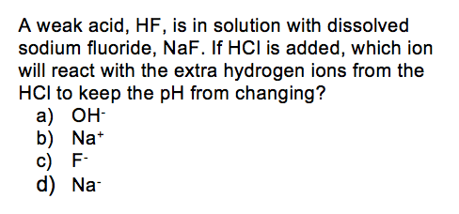
The Buffer Mechanism
Source
A buffer is able to resist pH change because the two components (conjugate acid and conjugate base) are both present in appreciable amounts at equilibrium and are able to neutralize small amounts of other acids and bases (in the form of H₃O⁺ and OH⁻) when they are added to the solution. Take, for example, a fluoride buffer made from hydrofluoric acid and NaF. An ideal fluoride buffer would contain equimolar concentrations of HF and NaF. Since they are a weak acid and a weak base, respectively, the amount of hydrolysis is minimal and both buffer species are present at, effectively, their initial supplied concentrations.
Video
If a strong acid is added to the HF/F⁻ buffer, then the the added acid will react completely with the available base, F⁻. This results in a nearly unchanged [H₃O⁺] and a nearly unchanged pH.
H₃O⁺_{(aq)} + F⁻_{(aq)} → HF_{(aq)} + H₂O_{(l)}
If a strong base is added to the HF/F⁻ buffer, then the added base will react completely with the available acid, HF. This results in a nearly unchanged [H₃O⁺] and a nearly unchanged pH.
HF_{(aq)} + OH⁻_{(aq)} → F⁻_{(aq)} + H₂O_{(l)}
The slight shift in pH after challenge is governed by the hydrolysis equilibrium of HF, based on the new HF and F⁻ concentrations:
HF_{(aq)} + H₂O_{(l)} ⇌ F⁻_{(aq)} + H₃O⁺_{(aq)}
LO 6.20: The student can identify a solution as being a buffer solution and explain the buffer mechanism in terms of the reactions that would occur on addition of acid/base.

Slide 24
K_{sp} and Solubility Calculations
Source
Question:
What is the maximum number of moles of AgBr that will fully dissolve in 1.0 L of water, if the Ksp value of silver bromide is 4.0 x 10⁻¹²?
4.0 x 10⁻¹² b. 2.0 x 10⁻¹² c. 4.0 x 10⁻⁶ d. 2.0 x 10⁻⁶
Answer:
The correct answer is “d” 2.0 x 10⁻⁶ . To determine the solubility of AgBr we need to determine the maximum concentrations of Ag+ and Br- that will equal the equilibrium constant. The Ksp equation is
Ksp = [Ag+][Br-] with [Ag+] = [Br-] = X, so to solve for X we need to take the square root of 4.0 x 10⁻¹²
Video
Click reveals answer and explanation.
LO 6.21: The student can predict the solubility of a salt, or rank the solubility of salts,
given the relevant K_{sp} values.

Slide 25
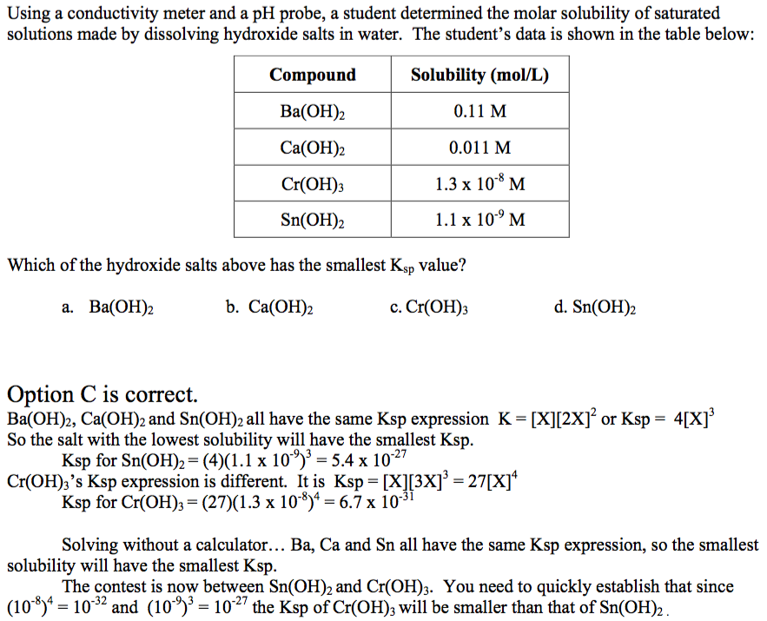
Find a K_{sp} from solubility data
Source
Video
Click reveals answer and explanation.
LO 6.22: The student can interpret data regarding solubility of salts to determine, or
rank, the relevant Ksp values.

Slide 26
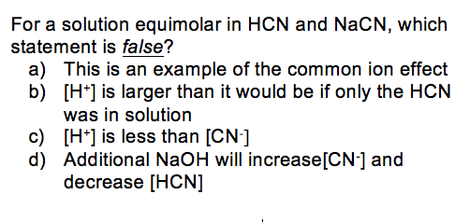
Common Ion Effect
Source
The solubility of a sparingly soluble hydroxide can be greatly increased by the addition of an acid. For example, the hydroxide salt Mg(OH)₂ is relatively insoluble in water:
Mg(OH)_{2(s)} ⇌ Mg²⁺_{(aq)} + 2OH⁻_{(aq)} With Ksp=5.61×10⁻¹²
When acid is added to a saturated solution that contains excess solid Mg(OH)₂, the following reaction occurs, removing OH− from solution:
H⁺_{(aq)} + OH⁻_{(aq)}→H₂O_{(l)}
The overall equation for the reaction of Mg(OH)₂ with acid is thus
Mg(OH)_{2(s)} + 2H⁺_{(aq)} ⇌ Mg²⁺_{(aq)} + 2H₂O_{(l}) (18.7.7)
As more acid is added to a suspension of Mg(OH)₂, the equilibrium shown in Equation 18.7.7 is driven to the right, so more Mg(OH)₂ dissolves.
Video
In contrast, the solubility of a sparingly soluble salt may be decreased greatly by the addition of a common ion. For example, if MgCl₂ is added to a saturated Mg(OH)₂ solution, additional Mg(OH)₂ will precipitate out. The additional Mg²⁺ ions will shift the original equilibrium to the left, thus reducing the solubility of the magnesium hydroxide.
LO 6.23: The student can interpret data regarding the relative solubility of salts in terms of factors (common ions, pH) that influence the solubility.

Slide 27
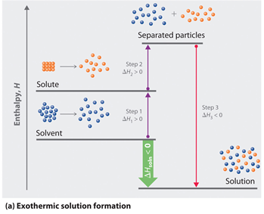
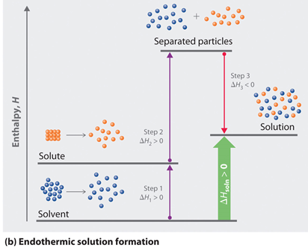
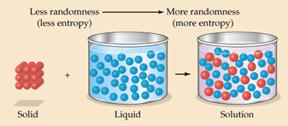
Salt dissolution: ∆H and ∆S
Source
The enthalpy (∆H_{soln}) of dissolution is dependent upon the intermolecular forces of the solute and solvent.
Video
Java Tutorial
The entropy (∆S_{soln}) of dissolution generally increases the disorder of the system.
LO 6.24: The student can analyze the enthalpic and entropic changes associated with the dissolution of a salt, using particulate level interactions and representations.

Slide 28
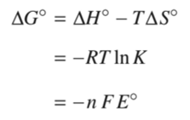
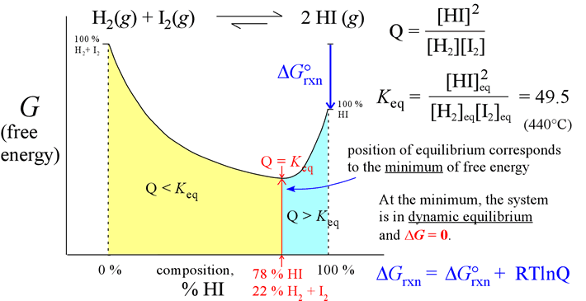
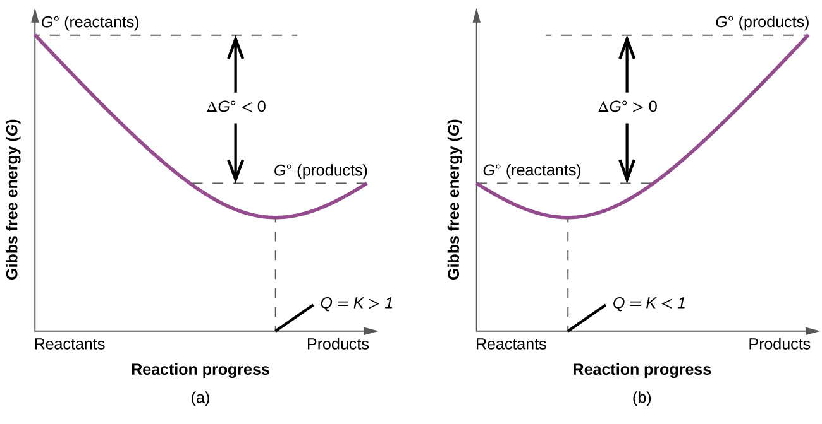
K, ∆G° and thermodynamic favorability
Source
G°_{reactants}
Video
∆G°rxn <0
Q=1,
m = ∆G
G°_{products}
Extent of Reaction
The key to understanding the relationship between ∆G° and K is recognizing that the magnitude of ∆G° tells us how far the standard-state is from equilibrium. The smaller the value of ∆G° , the closer the standard-state is to equilibrium. The larger the value of ∆G°, the further the reaction has to go to reach equilibrium.
LO 6.25: The student is able to express the equilibrium constant in terms of ∆G ° and RT and use this relationship to estimate the magnitude of K and, consequently, the thermodynamic favorability of the process.

