Slide 1
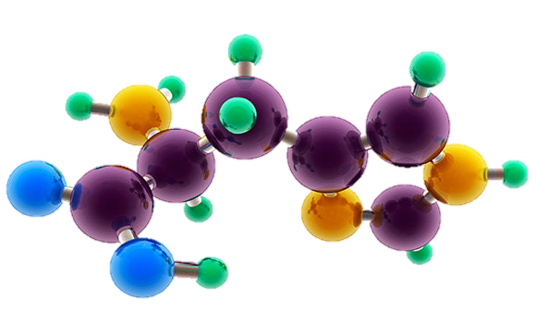
AP Chemistry Exam Review

Slide 2
Big Idea #3
Chemical Reactions

Slide 3
Changes in matter involve the rearrangement and/or reorganizations of atoms and/or the transfer of electrons.

Slide 4
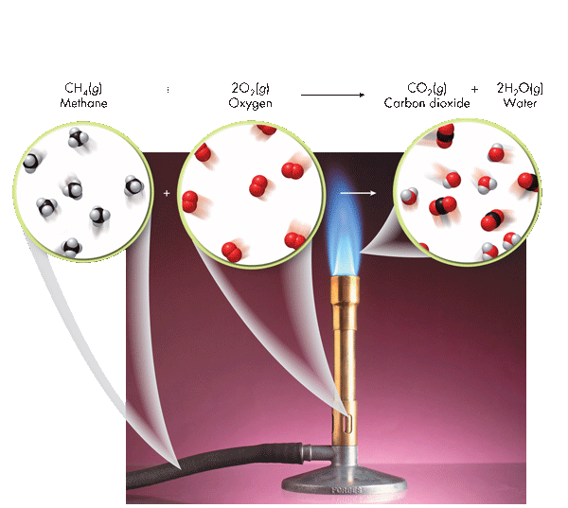
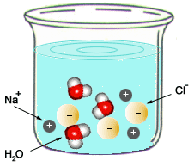
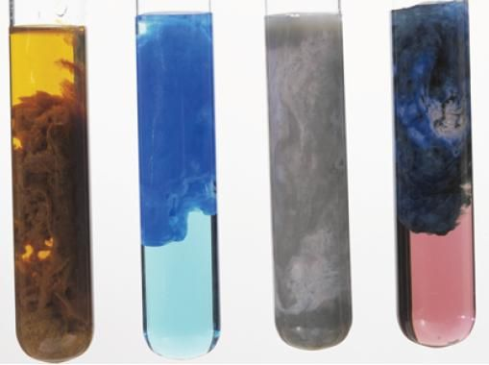
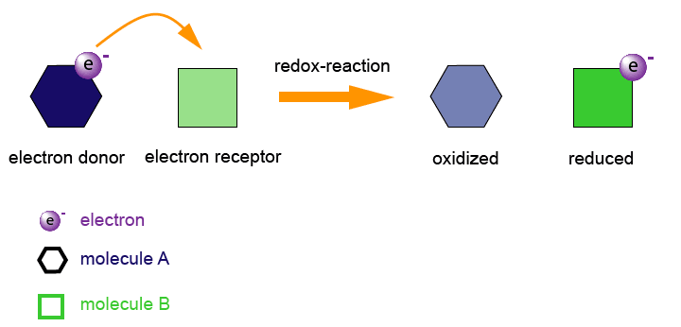
Types of Chemical Reactions
Source
Combustion
C_{x}H_{x} + O₂ → CO₂ + H₂O
Acid-Base (Neutralization)
HA + BOH → H₂O + BA
Video
C. Pearson Chemistry. Boston, MA: Pearson, 2012. Print.
Oxidation-Reduction
A ⁺ + e⁻ → A
B → B + e⁻
Precipitation
AB (aq) + CD (aq)→ AD (aq) + CB (s)
LO 3.1: Students can translate among macroscopic observations of change, chemical equations, and particle views.

Slide 5
Types of Chemical Reactions
Source
Combustion
C_{x}H_{x} + O₂ → CO₂ + H₂O
Acid-Base (Neutralization)
HA + BOH → H₂O + BA
Video
C. Pearson Chemistry. Boston, MA: Pearson, 2012. Print.
Oxidation-Reduction
A ⁺ + e⁻ → A
B → B + e⁻
Precipitation
AB (aq) + CD (aq)→ AD (aq) + CB (s)
LO 3.1: Students can translate among macroscopic observations of change, chemical equations, and particle views.

Slide 6
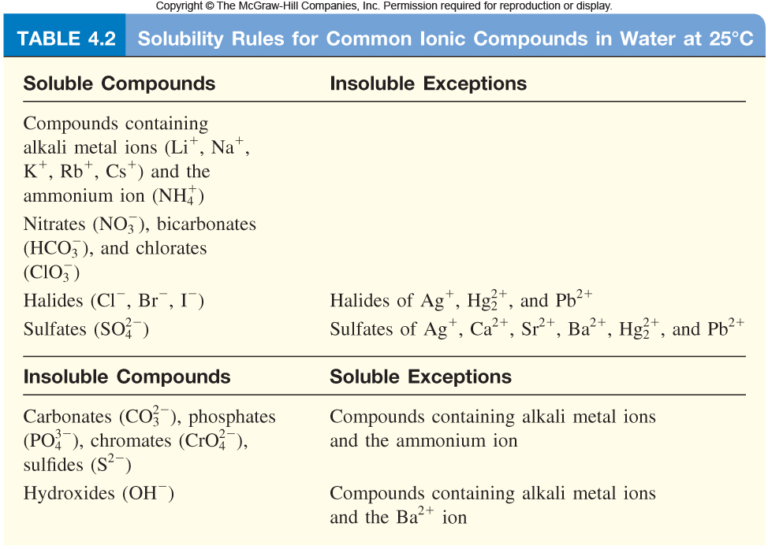
Balanced Equations
Source
Complete Molecular: | AgNO₃ (aq) + KCl (aq) ⎯→ AgCl (s) + KNO₃ (aq)
Complete Ionic : | Ag⁺(aq) + NO₃⁻(aq) + K⁺(aq) + Cl⁻(aq) ⎯→ AgCl (s) + K⁺(aq) + NO₃⁻(aq)
Net Ionic : | Ag⁺(aq) + Cl⁻(aq) ⎯→ AgCl (s)
Video
Quizlet
Spectator ions should not be included in your balanced equations.
Remember, the point of a Net Ionic Reaction is to show only those ions that are involved in the reaction. Chemists are able to substitute reactants containing the same species to create the intended product.
You only need to memorize that compounds with nitrate, ammonium, halides and alkali metals are soluble.
LO 3.2: The student can translate an observed chemical change into a balanced chemical equation and justify the choice of equation type (molecular, ionic, or net ionic) in terms of utility for the given circumstances.

Slide 7
Making Predictions
Source
Solid copper carbonate is heated strongly:
CuCO₃ (s) → CuO (s) + CO₂ (g)
What evidence of a chemical change would be observed with this reaction?
One would observe a color change and evolution of a gas
What is the percent yield of CO₂ if you had originally heated 10.0g CuCO₃ and captured 3.2g CO₂ ?
Step 1: Find the Theoretical Yeild
10.0g CuCO₃ x(1mol/123.555g) x (1mol CO₂ /1 molCuCO₃ ) X 44.01gCO₂/mol = 3.562 gCO₂
Step 2: Find Percent Yield
(3.2 g / 3.562 g) * 100 = 89.8 % → 90% with correct sig figs
How could you improve your percent yield?
-reheat the solid, to see if there is any further mass loss
-make sure you have pure CuCO₃
Click reveals answer and explanation.
Video
Click reveals answer and explanation.
Click reveals answer and explanation.
Click reveals answer and explanation.
LO 3.3: The student is able to use stoichiometric calculations to predict the results of performing a reaction in the laboratory and/or to analyze deviations from the expected results.

Slide 8
Limiting Reactants – D.A.
Source
Al₂S₃ + 6 H₂O ---> 2Al(OH)₃ + 3 H₂S
15.00 g aluminum sulfide and 10.00 g water react
Identify the Limiting Reactant
Video
Sim
pHet
Click reveals answer and explanation.
15.00g Al₂S₃ x (1mol/ 150.158 g) x (6mol H₂O/1mol Al₂S₃) x (18g/mol H₂0 ) = 10.782 g H₂0 needed
10g H₂0 x (1mol/ 18.015 g) x (1 mol Al₂S₃ / 6mol H₂O) x (150.158 g/mol) = 13.892g Al₂S₃ needed
H₂0 is limiting, because we need more than we were given
b) What is the maximum mass of H₂S which can be formed from these reagents?
Theoretical Yield
10.00 g H₂0 x (1mol/ 18.015 g) x (3/6) x (34.0809 g/mol ) = 9.459 g H₂S produced
Click reveals answer and explanation.
c) How much excess reactant is left in the container?
Click reveals answer and explanation.
15.00 g – 13.892 g = 1.11g Al₂S₃
**Dimensional Analysis is not the only way to solve these problems. You can also use BCA tables (modified ICE charts), which may save time on the exam →
LO 3.4: The student is able to relate quantities (measured mass of substances, volumes of solutions, or volumes and pressures of gases) to identify stoichiometric relationships for a reaction, including situations involving limiting reactants and situations in which the reaction has not gone to completion.

Slide 9
Limiting Reactants – BCA Table
Source
15.00 g aluminum sulfide and 10.00 g water react according to the following equation:
Al₂S₃ + 6 H₂O ---> 2Al(OH)₃ + 3 H₂S
Identify the Limiting Reactant
Video
Click reveals answer and explanation.
15.00g Al₂S₃ x (1mol/ 150.158 g) = .100mol
10g H₂0 x (1mol/ 18.015 g) = .555
Water is the limiting reactant.
 | Al₂S₃ | 6 H₂O | 2Al(OH)₃ | 3 H₂S
Before | .0999 | .5551 | 0 | 0
Change | -.0925 | -.5551 | + .1850 | + .2775
After | .0074 | 0 | .1850 | .2775
Complete the table using the molar relationships
b) What is the maximum mass of H₂S which can be formed from these reagents?
0.2775 mol H₂S x (34.0809 g/mol ) = 9.459 g H₂S produced
Click reveals answer and explanation.
c) How much excess reactant is left in the container?
Click reveals answer and explanation.
.0074mol Al₂S₃ x 150.158 g/mol = 1.11g Al₂S₃
LO 3.4: The student is able to relate quantities (measured mass of substances, volumes of solutions, or volumes and pressures of gases) to identify stoichiometric relationships for a reaction, including situations involving limiting reactants and situations in which the reaction has not gone to completion.

Slide 10
Experimental Design
Source
Synthesis
A sample of pure Cu is heated in excess pure oxygen. Design an experiment to determine quantitatively whether the product is CuO or Cu₂O.
Find the mass of the copper. Heat in oxygen to a constant new mass. Subtract to find the mass of oxygen that combined with the copper. Compare the moles of oxygen atoms to the moles of original copper atoms to determine the formula.
Video
Click reveals basic steps
Decomposition CaCO₃(s) → CaO(s) + CO₂(g)
Design a plan to prove experimentally that this reaction illustrates conservation of mass.
Find the mass of calcium carbonate and seal it in a rigid container. Evacuate the container of remaining gas. Heat the container and take pressure readings (this will be the pressure exerted by the CO₂). Using PV=nRT, calculate the moles of carbon dioxide gas present in the container and compare it to the molar relationships afforded by the balanced chemical equation.
Click reveals basic steps
LO3.5: The student is able to design a plan in order to collect data on the synthesis or decomposition of a compound to confirm the conservation of matter and the law of definite proportions.

Slide 11
Data Analysis
Source
When tin is treated with concentrated nitric acid, and the resulting mixture is strongly heated, the only
remaining product is an oxide of tin. A student wishes to find out whether it is SnO or SnO2. Mass of pure tin 5.200 grams.
Mass of dry crucible 18.650 g
Mass of crucible + oxide after first heating 25.500 g
Mass after second heating 25. 253 g
Mass after third heating 25. 252 g
How can you use this data, and the law of conservation of mass, to determine the formula of the product?
Video
1) Determine the number of moles of tin. 5.200/118.7 = 0.0438 moles. Sn
2) Subtract the mass of the crucible from the mass after the third heating. 25.252-18.650 = 6.602 g SnO_{x}
3) Subtract the mass of tin from the mass of oxide to get the mass of oxygen. 6.602-5.200 = 1.402 grams of oxygen.
4) Calculate the moles of oxygen atoms, and divide by the moles of tin atoms to get the formula ratio.
1.402 g/16.00 g/mol of atoms = 0.0876 moles. 0.0876/0.0438 = 2.00
The formula must be SnO₂.
Click reveals answer and explanation.
LO 3.6: The student is able to use data from synthesis or decomposition of a compound to confirm the conservation of matter and the law of definite proportions.

Slide 12
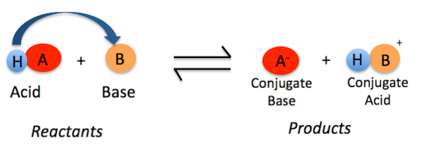
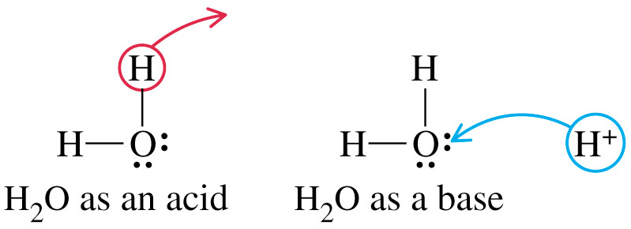
Bronsted-Lowery Acids & Bases
Source
According to Bronsted-Lowery (B.L.) an acid is a "proton donor" and a base is a "proton acceptor.“ The proton here is shown as a hydrogen.
The acid’s conjugate base is the anion.
The base’s conjugate acid now has the proton (hydrogen ion).
Video
Quizlet
Amphoteric nature of water
Water acts as both an acid & a base.
H₂O ←→ H⁺ + OH⁻
2H₂O ←→ H₃O⁺ + OH⁻
LO 3.7: The student is able to identify compounds as Bronsted-Lowry acids, bases and/or conjugate acid-base pairs, using proton-transfer reactions to justify the identification.

Slide 13
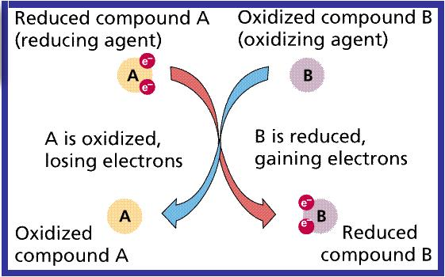
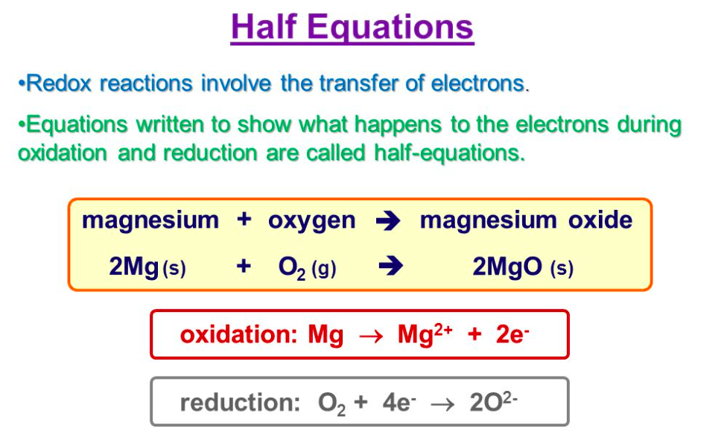
Redox Reactions
Source
When an electron is transferred, it is called a redox reaction. When something is reduced, the RED part of redox, it gains electrons. You may have a difficult time with this definition because when something is reduced, it usually means that it is losing something. In this case, it is a reduction in charge. Remember, electrons are negatively charged so if something is being reduced, it's getting more negatively charged by receiving more electrons. The other reaction that is coupled with this is called oxidation--the "OX" part of redox. Whenever something is reduced, the electron it gains has to come from somewhere. The oxidation is the loss of an electron, so if an atom is oxidized it loses its electron to another atom. And these are always coupled reactions. If one molecule is oxidized, another molecule must be reduced and vice versa: the electron must go somewhere.
Video
OILRIG
LO 3.8: The student is able to identify redox reactions and justify the identification in terms of electron transfer

Slide 14
Redox Titrations
Source
A redox titration (also called an
oxidation-reduction titration) can accurately determine the concentration of an unknown analyte by measuring it against a standardized titrant. A common example is the redox titration of a standardized solution of potassium permanganate (KMnO₄) against an analyte containing an unknown concentration of iron (II) ions (Fe²⁺). The balanced reaction in acidic solution is as follows:
MnO₄⁻ + 5Fe²⁺ + 8H⁺ → 5Fe³⁺ + Mn²⁺ + 4H₂O
In this case, the use of KMnO₄ as a titrant is particularly useful, because it can act as its own indicator; this is due to the fact that the KMnO₄ solution is bright purple, while the Fe²⁺ solution is colorless. It is therefore possible to see when the titration has reached its endpoint, because the solution will remain slightly purple from the unreacted KMnO₄
Video
LO 3.9: The student is able to design and/or interpret the results of an experiment involving a redox titration

Slide 15
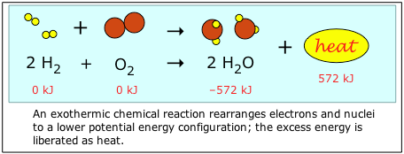
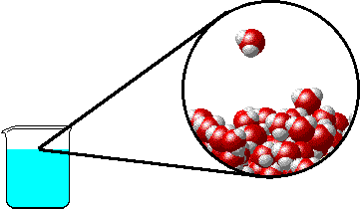
Evidence of Chemical Change
Source
Note: it is a common misconception that boiling water makes O₂ and H₂ gas. Notice that the water molecule stays intact as the water boils. Covalent bonds are not broken with during this phase change- only intermolecular attractions (hydrogen bonds) between water molecules.
Video
Video
Video
Chemical Changes:
Production of a gas:
2KClO₃ _{(s)} + heat → 2KCl _{(s)} + 3O_{2 (g)}
Formation of a precipitate:
AgNO₃) _{(aq)} + KCl _{(aq)} → AgCl _{(s)}+ 2KNO_{3 (aq)}
Change in color:
Two white solids react to produce a mixture of a yellow and a white solid when shaken forcefully!
Pb(NO₃)_{2 (s)} + 2KI _{(s)} → PbI₂ _{(s)}+ 2KNO_{3 (s)}
Production of heat*:
2 Mg _{(s)} + O_{2 (s)} → 2MgO _{(s)} + heat
*can also include the absorption of heat
Physical Changes:
may produce similar visible evidence (i.e. boiling water creates “bubbles,” but bonds are not broken and reformed. No new substances are made.
LO 3.10: Evaluate the classification of a process as a physical, chemical, or ambiguous change based on both macroscopic observations and the distinction between rearrangement of covalent interactions and noncovalent interactions.

Slide 16
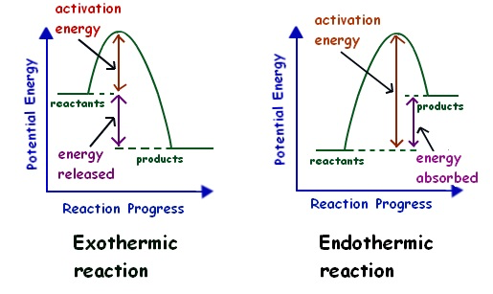
Energy Changes
Source
Chemical reactions involve the formation of new products
Bonds between atoms or ions in the reactants must be BROKEN (the enthalpy of the system is increasing … ENDOTHERMIC process)
Bonds are then FORMED between atoms or ions to make the producsts of the reaction. (the enthalpy of hte system is decreasing...EXOTHERMIC process)
Video
Video
LO 3.11: The student is able to interpret observations regarding macroscopic energy changes associated with a reaction or process to generate a relevant symbolic and/or graphical representation of the energy changes.

Slide 17
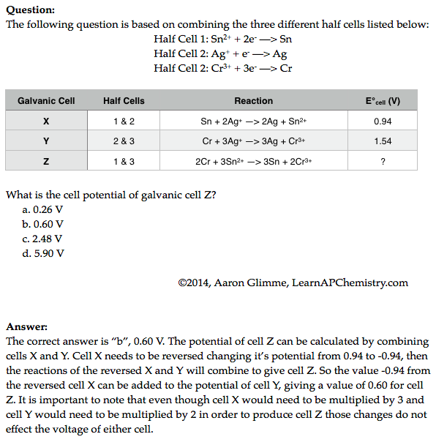
Galvanic Cell Potential
Source
Video
Video
Click reveals answer and explanation.
LO 3.12: Make qualitative or quantitative predictions about galvanic or electrolytic reactions based on half-cell reactions and potentials and/or Faraday’s laws.

Slide 18
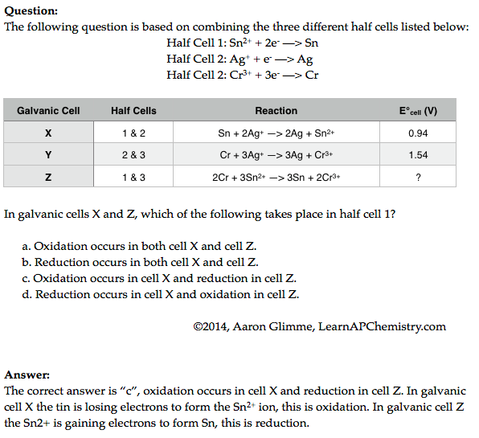
Redox Reactions and Half Cells
Source
Video
Video
LO 3.13: The student can analyze data regarding galvanic or electrolytic cells to identify properties of the underlying redox reactions

Slide 19
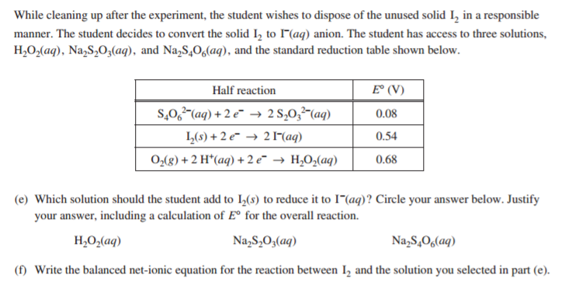
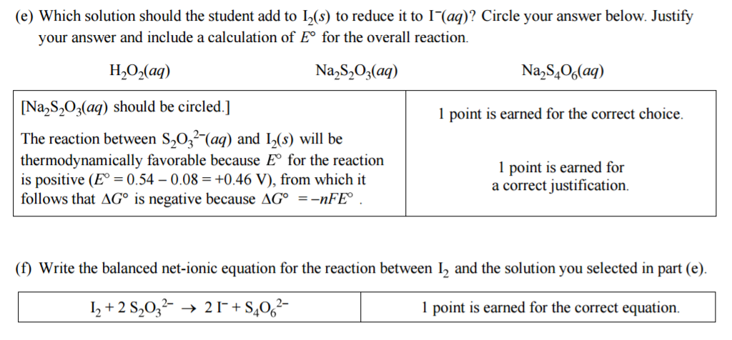
2016 FRQ #3
This question drew heavily from Big Idea #3

Slide 20
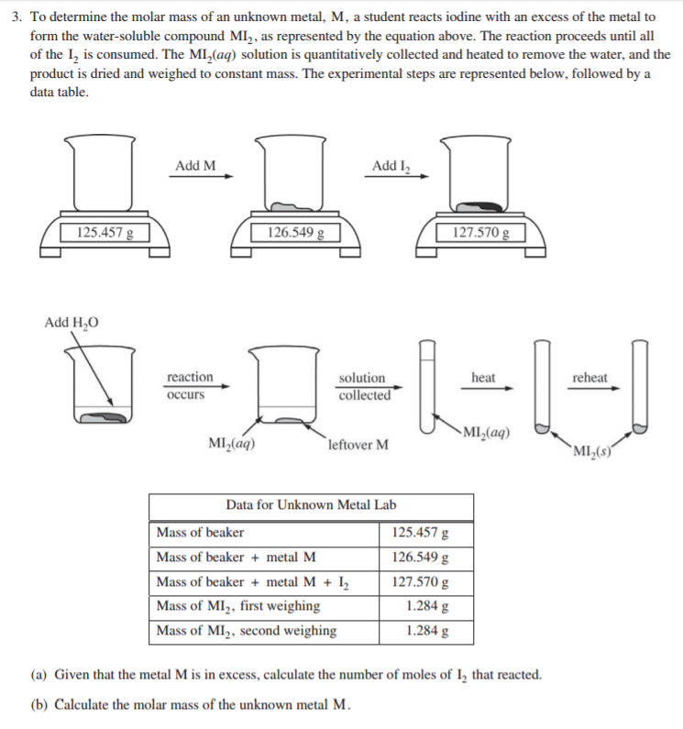
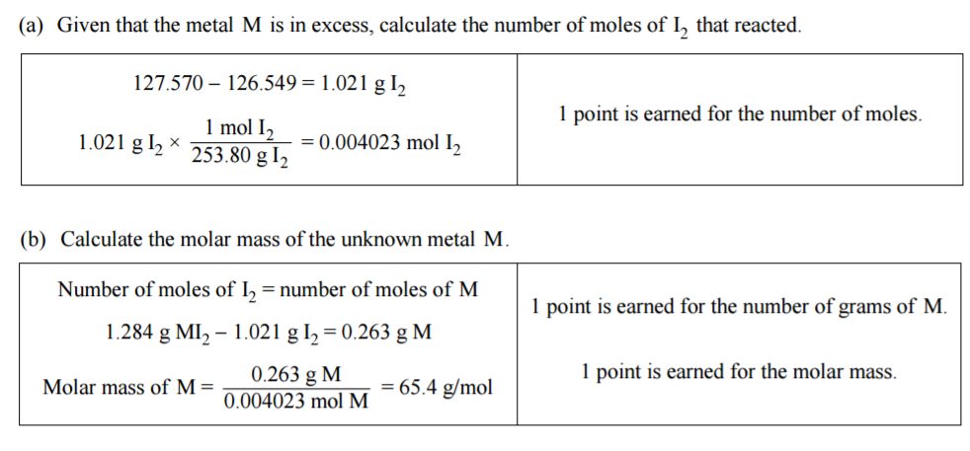
2016 FRQ #3
This question drew heavily from Big Idea #3

